Slide 1
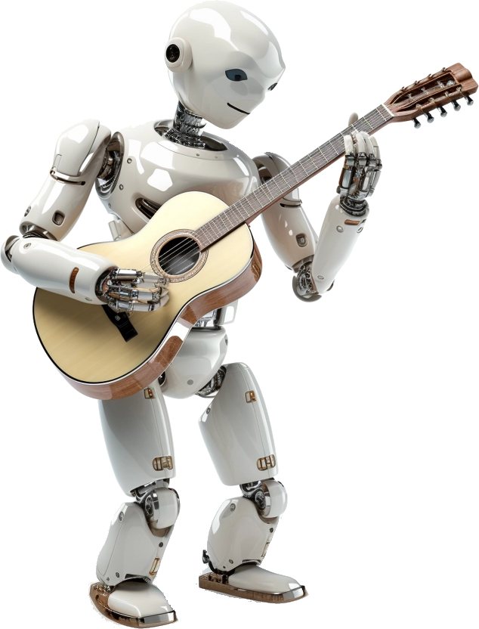
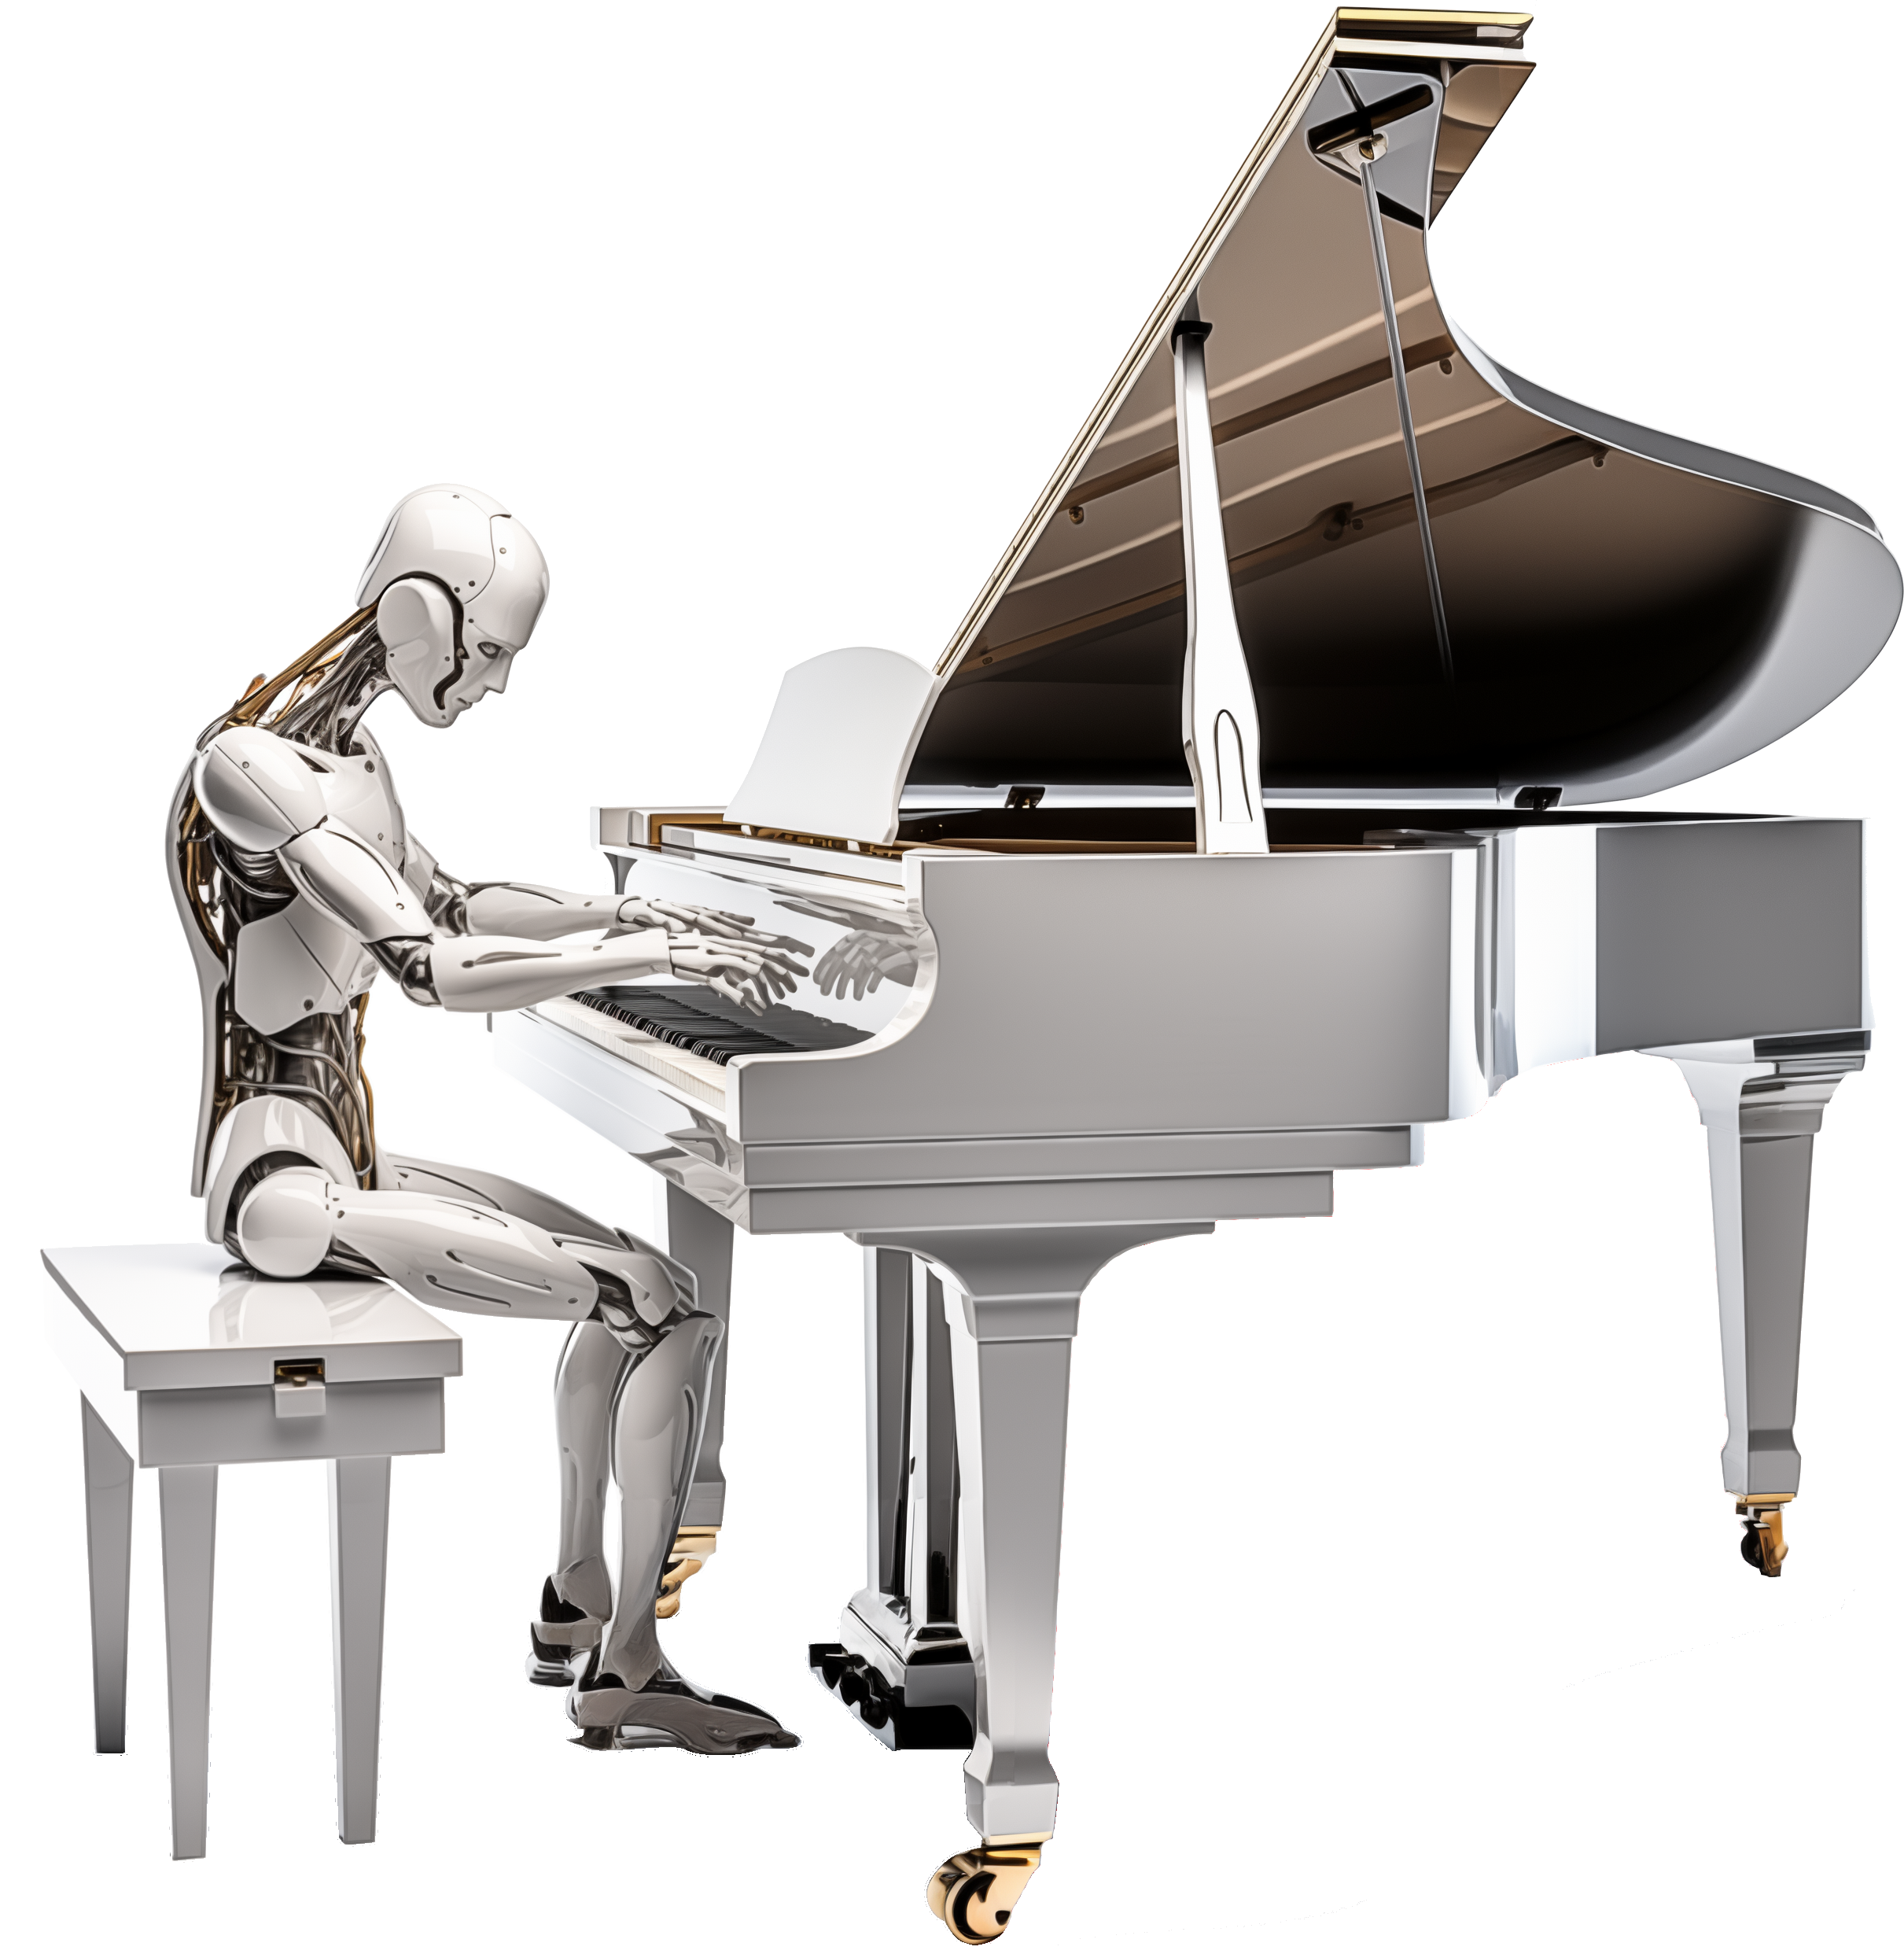
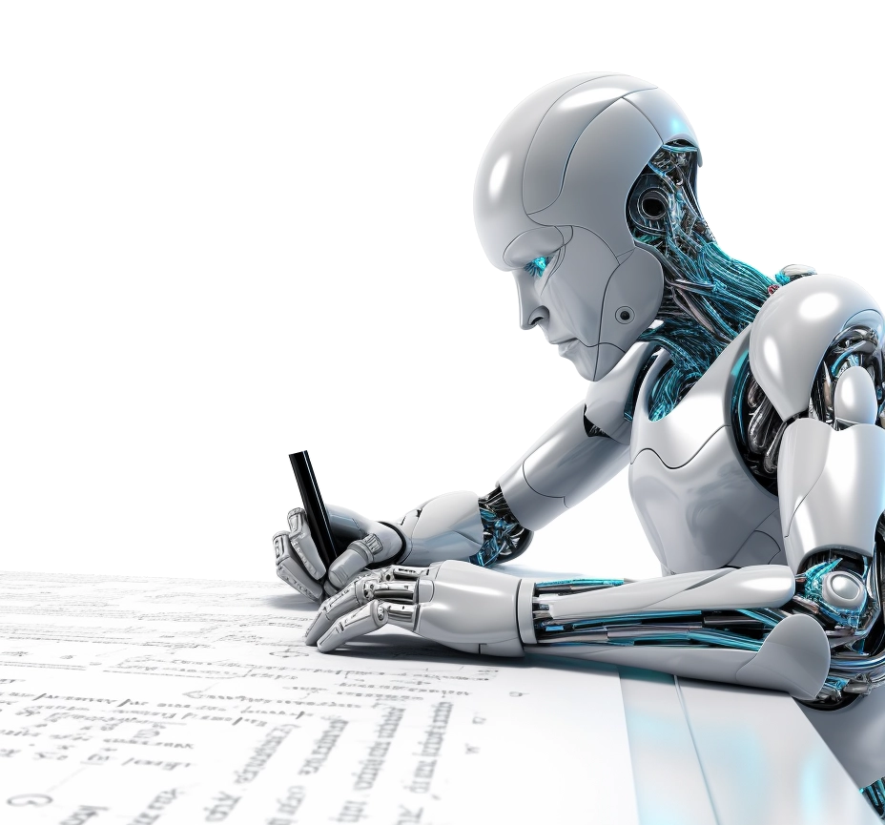
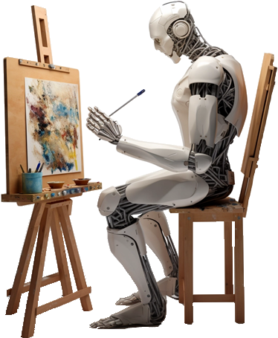
Generative Artificial Intelligence
Paul Dubois
Info@Lèze

Slide 2

Creating new words

Slide 3
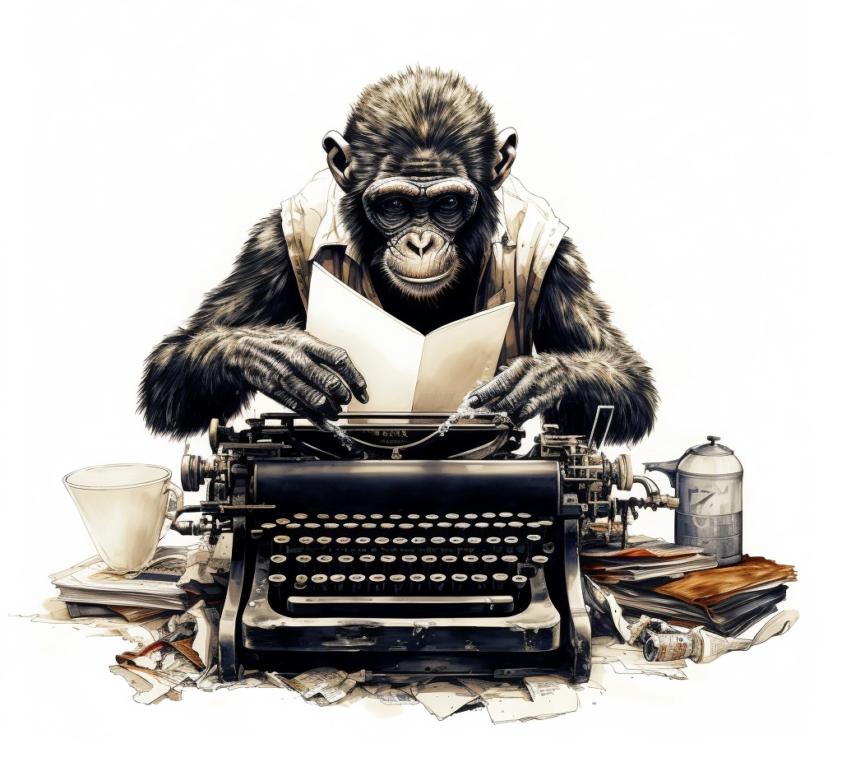
Method 1:
Randomly type on a keyboard

Slide 4
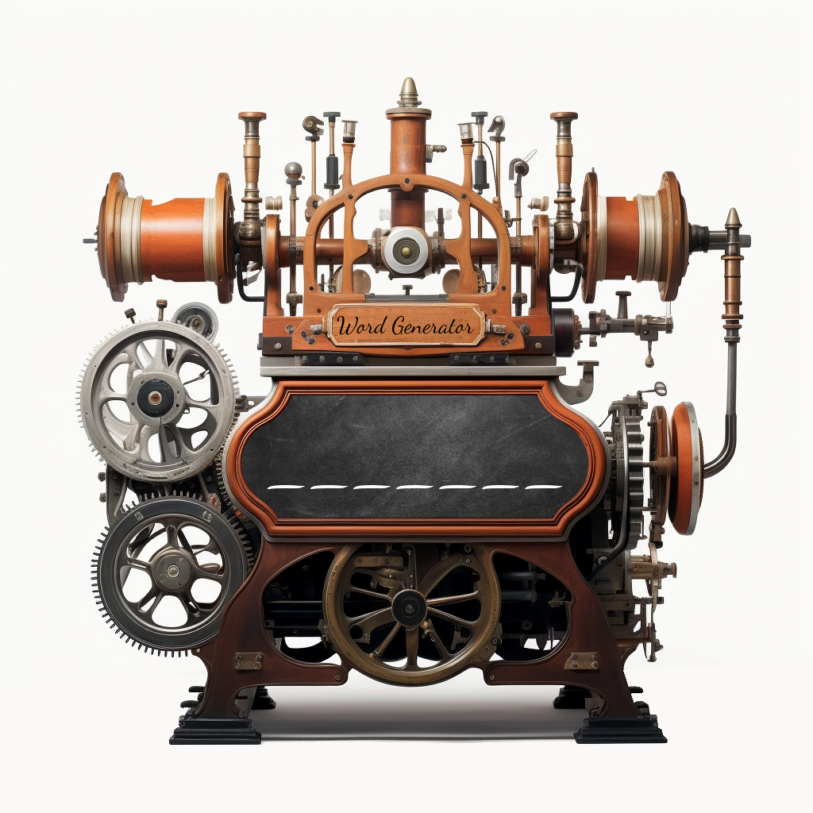
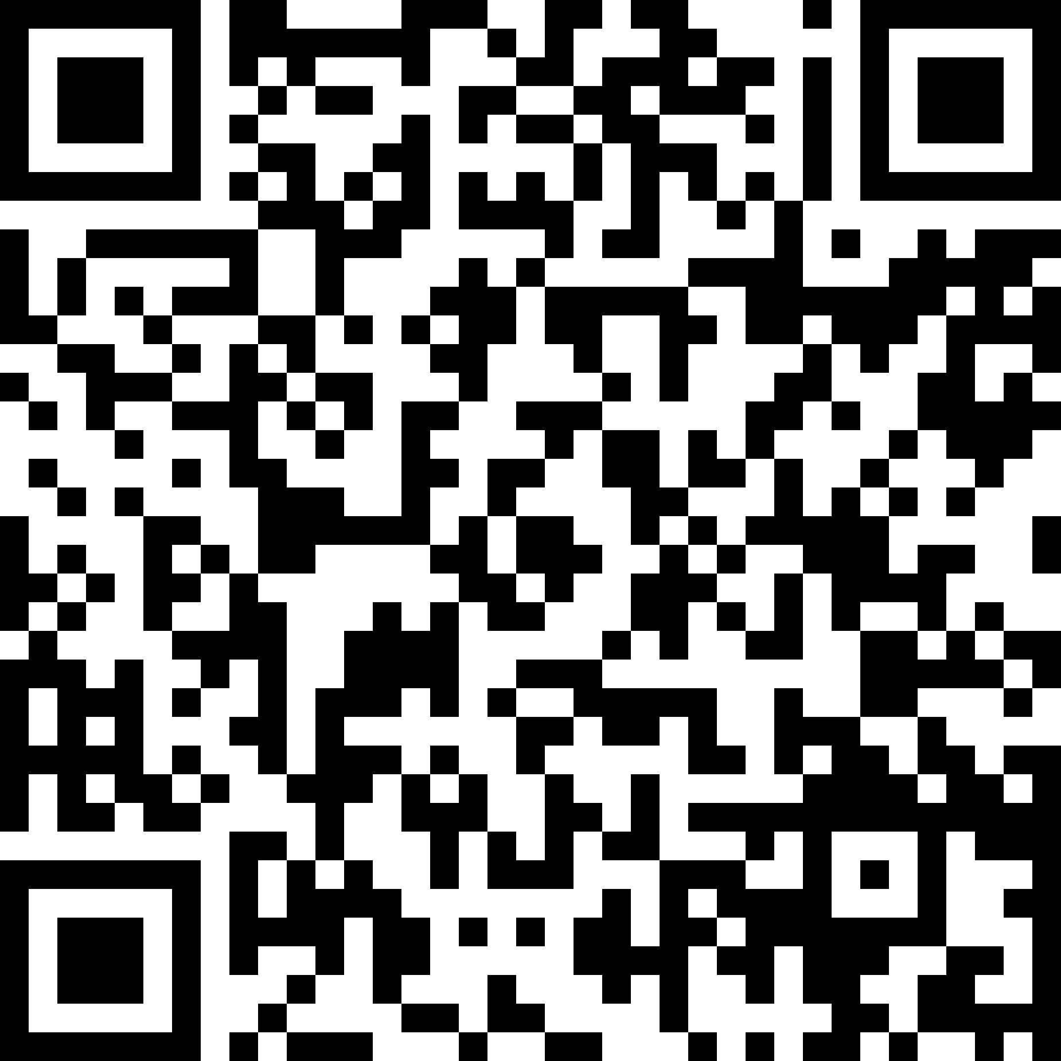
Words Generator Machine 1
https://pauldubois98.github.io/GenerativeAI/word_generator1.html

Slide 5
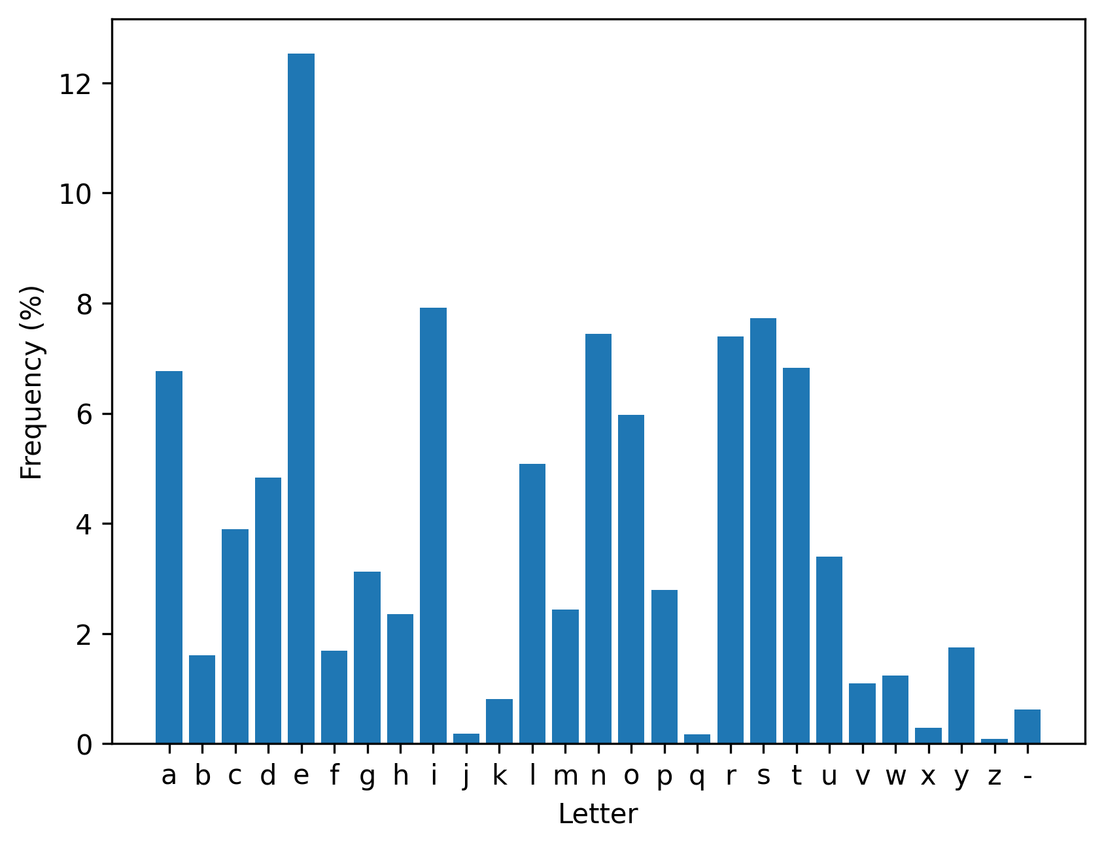
Letters usage (in dictionary)

Slide 6
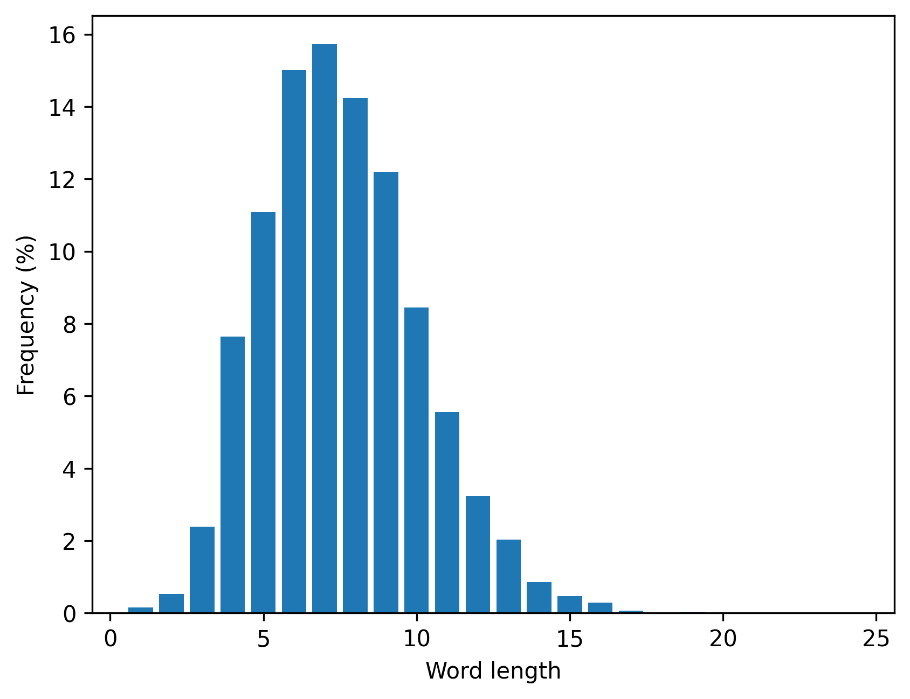
Words lengths (in dictionary)

Slide 7
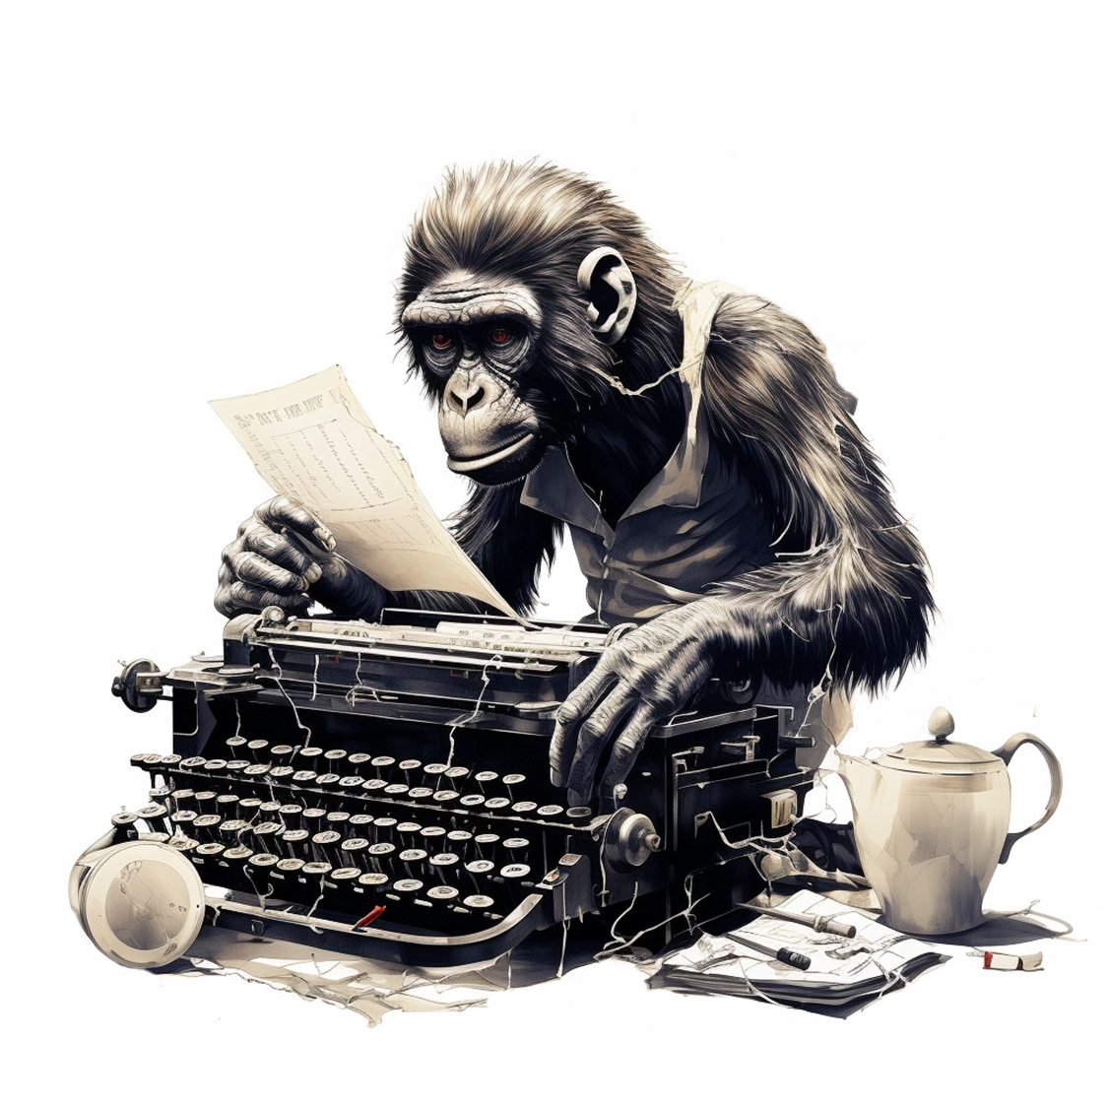
Method 2:
Type on a weighted keyboard

Slide 8
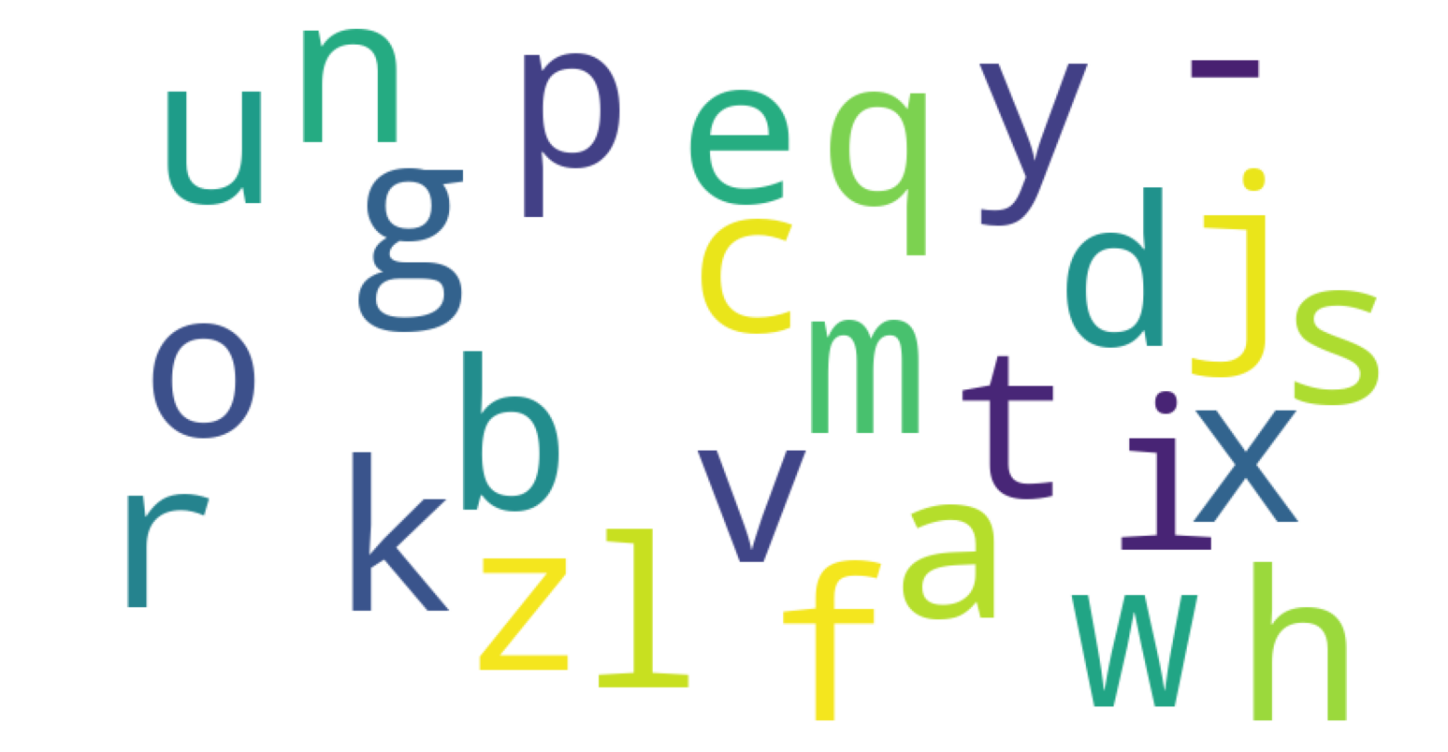
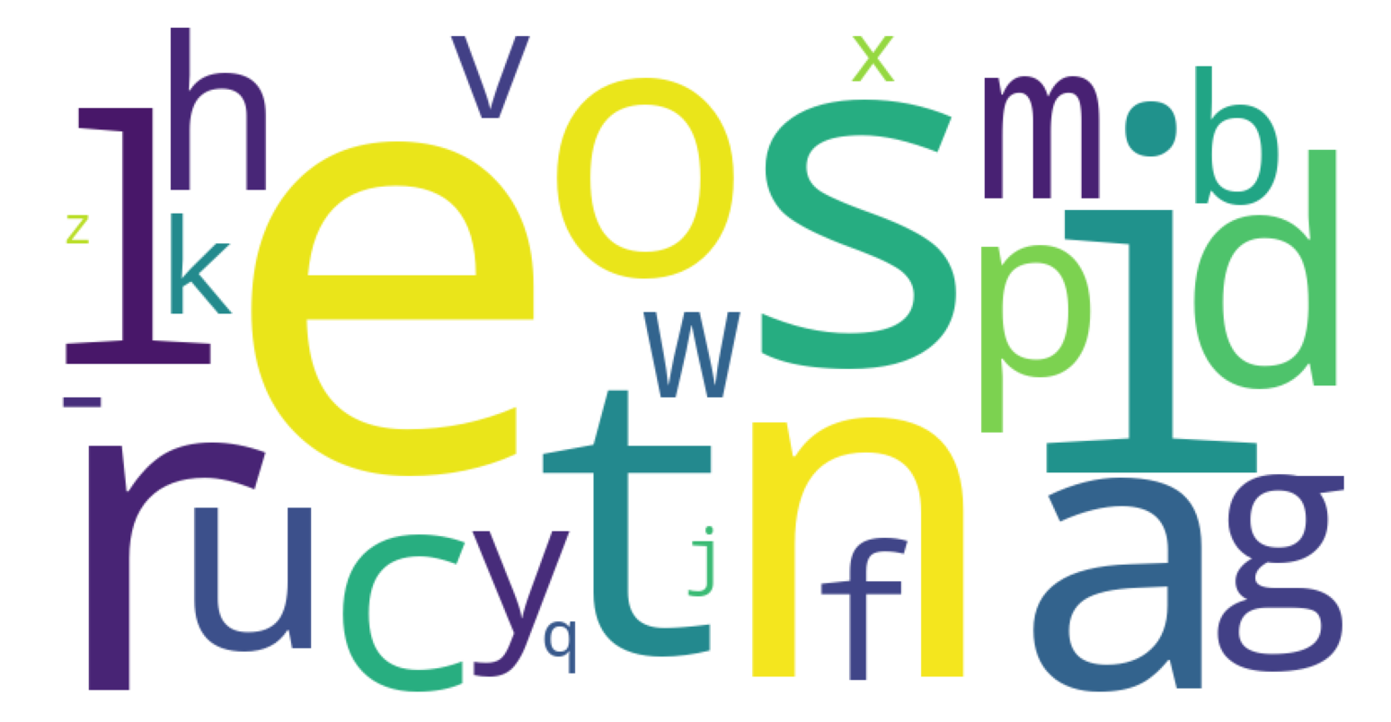
What is a “weighted” keyboard?
Non-weighted
Weighted

Slide 9
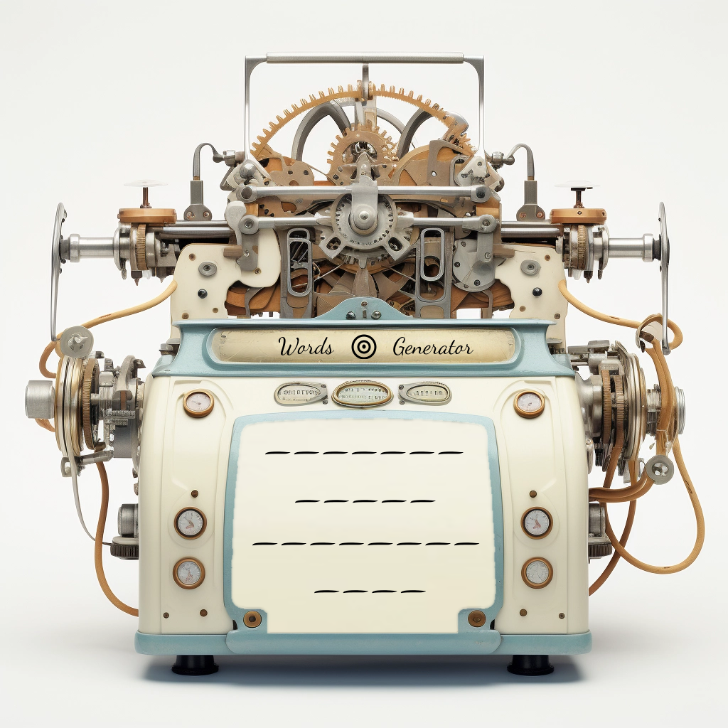
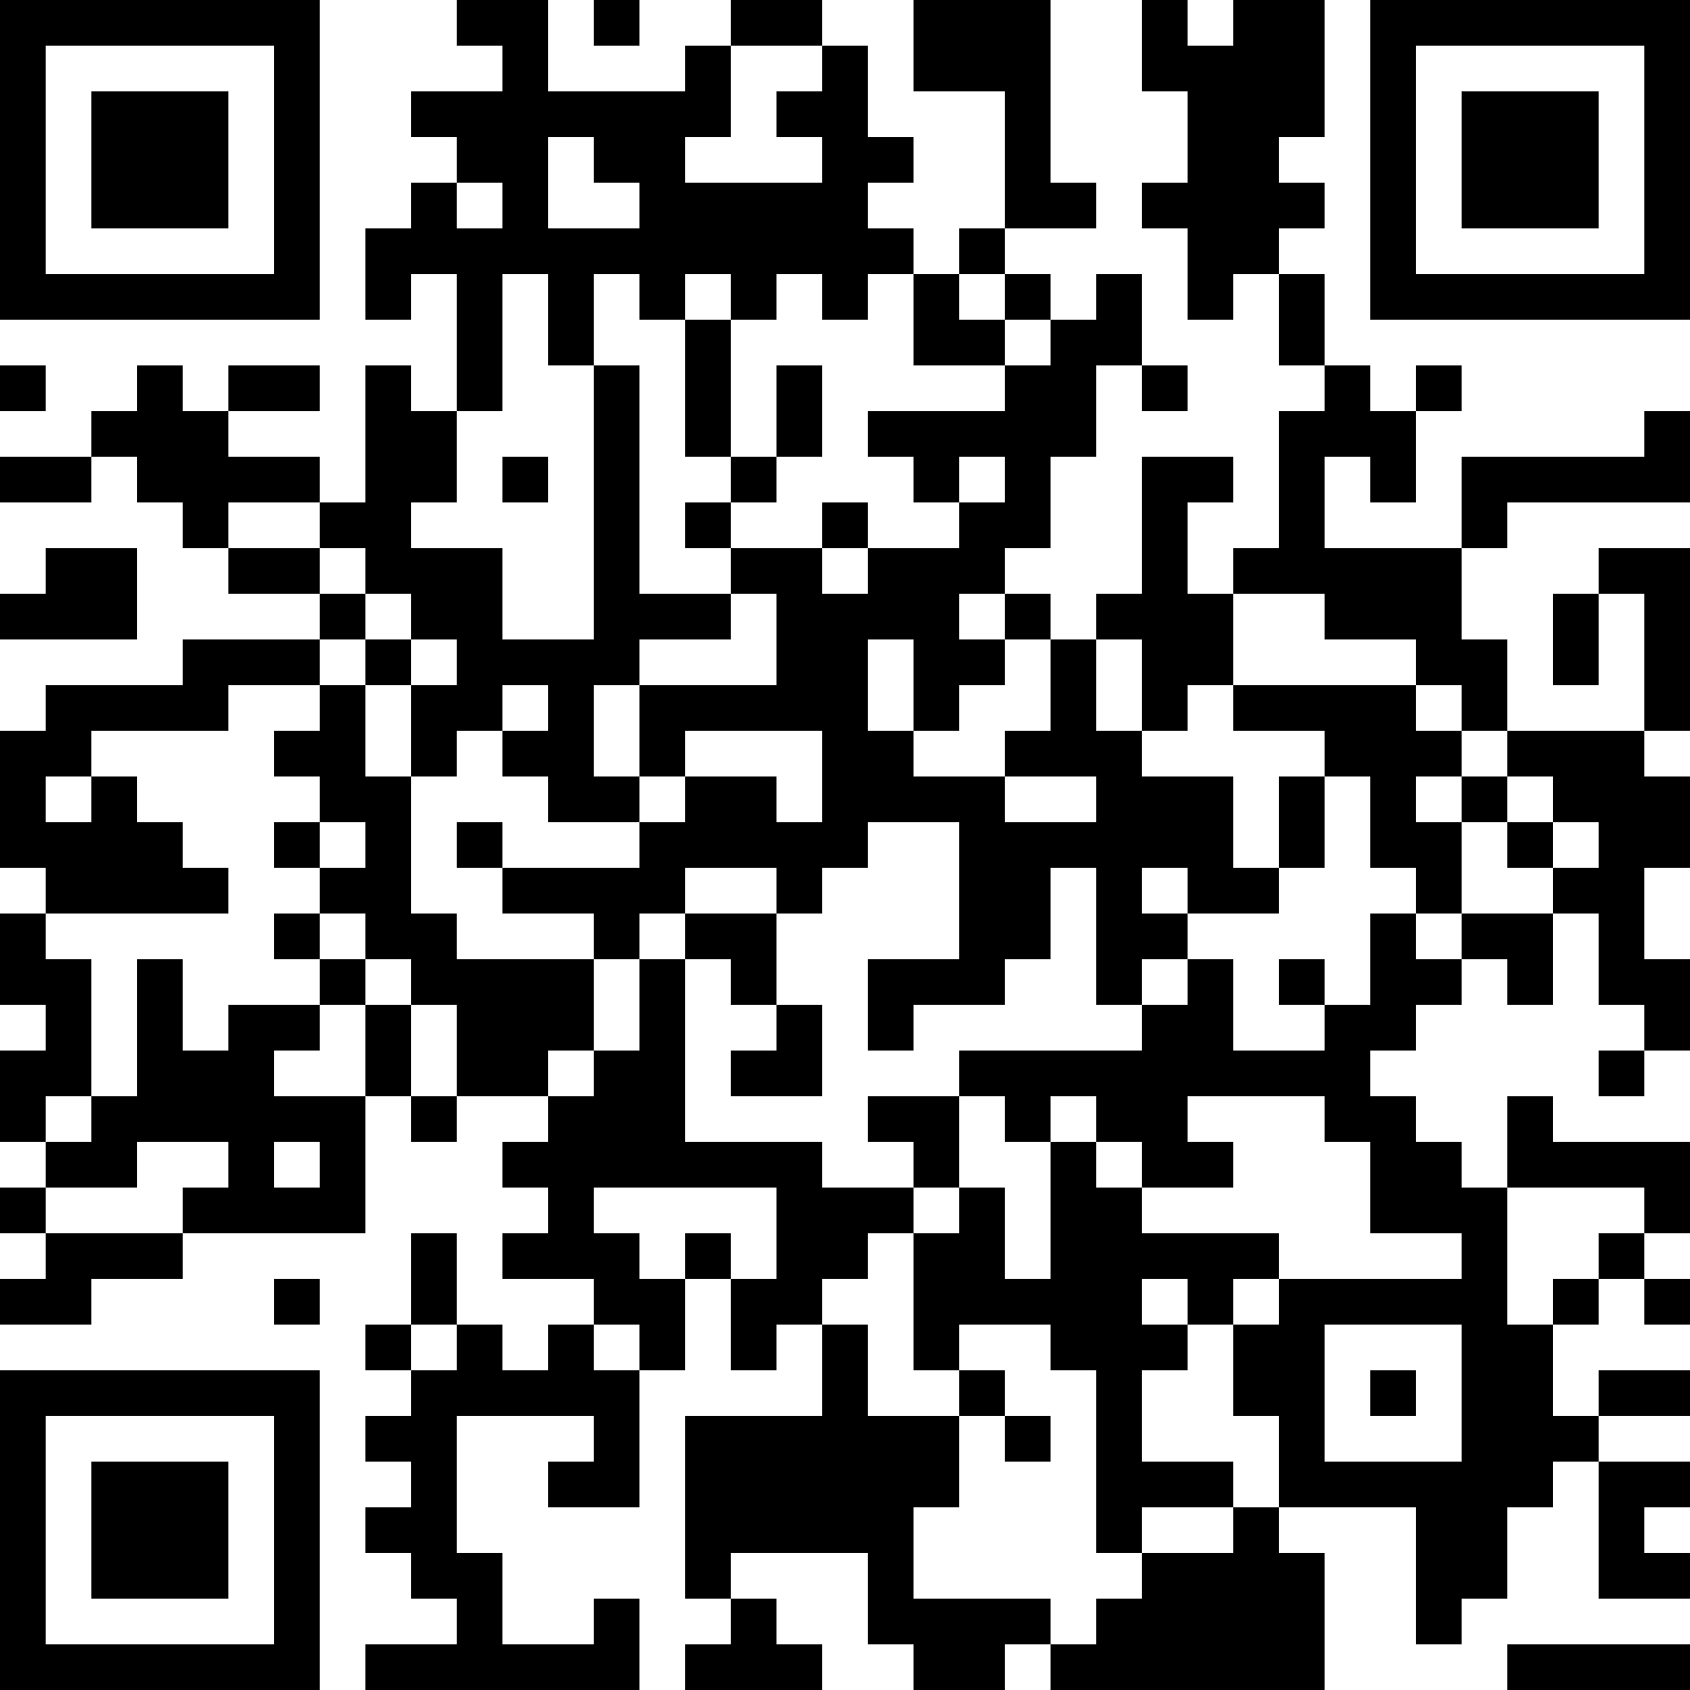
Words Generator Machine 2
https://pauldubois98.github.io/GenerativeAI/word_generator2.html

Slide 10
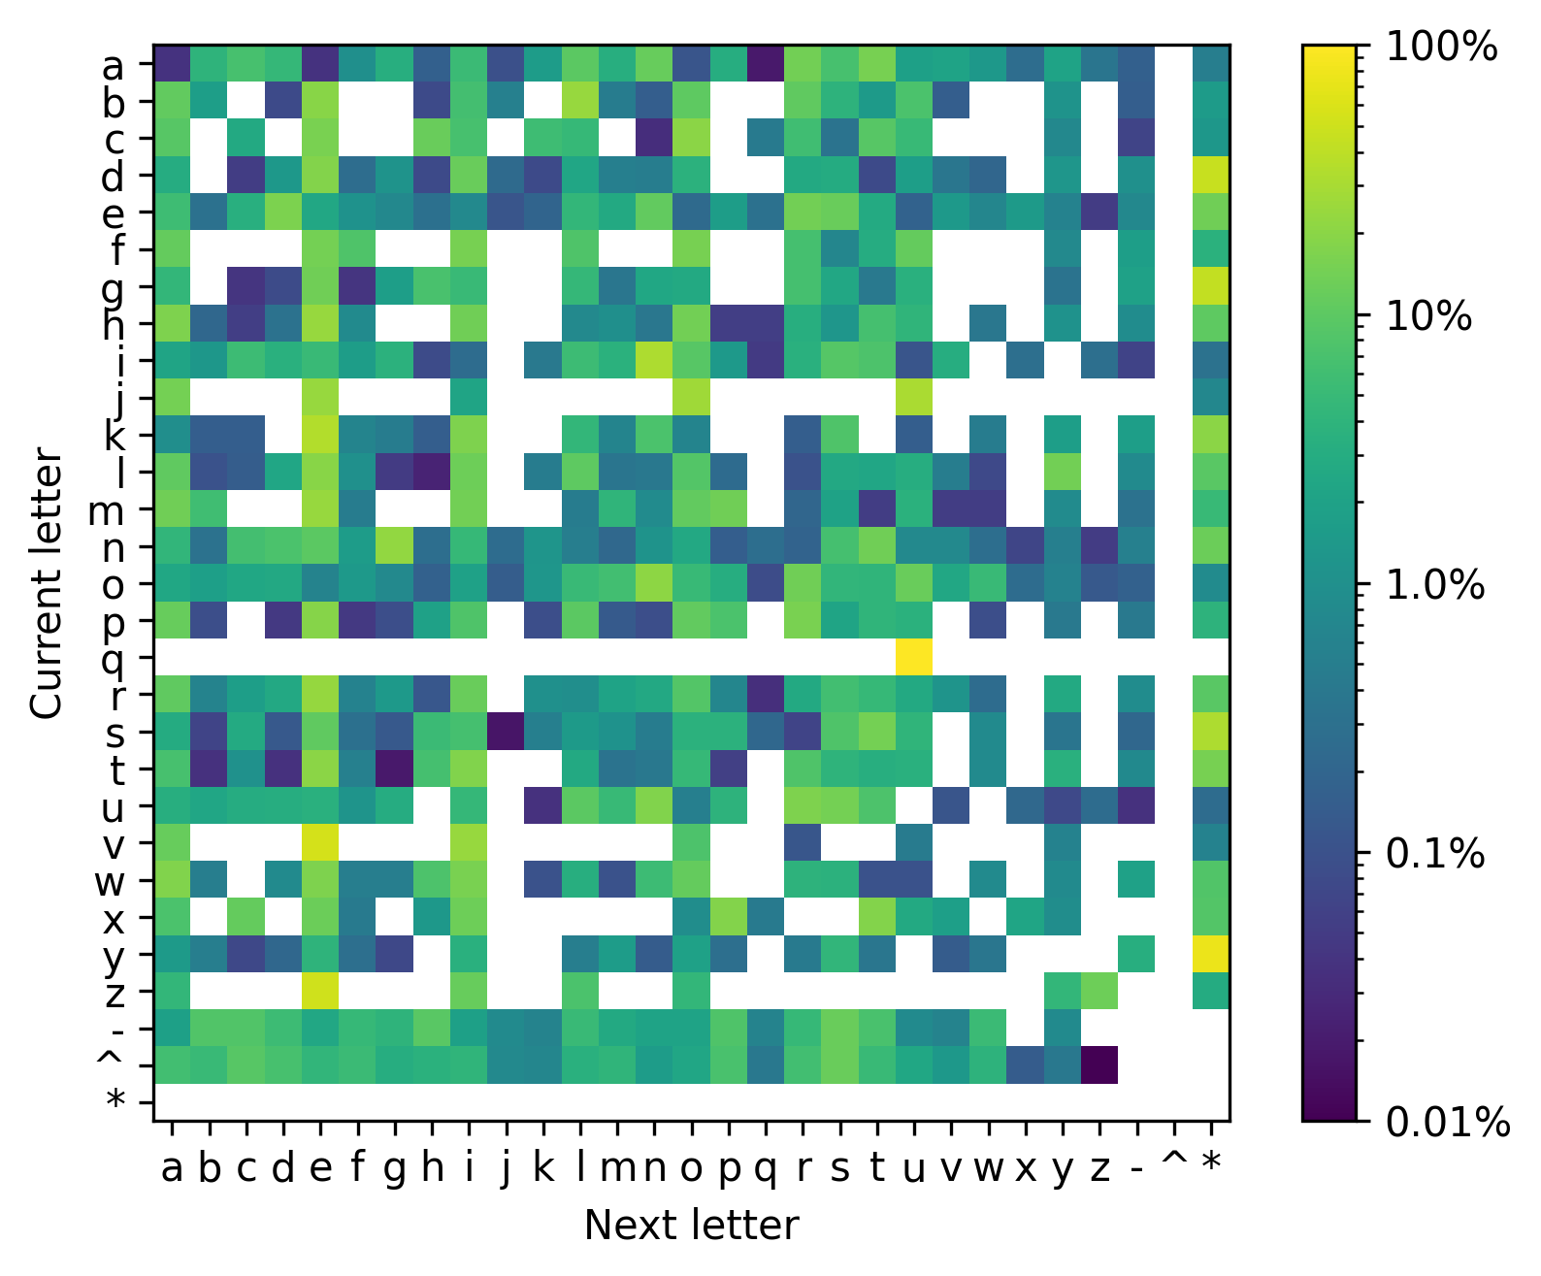
Markov Heatmap

Slide 11
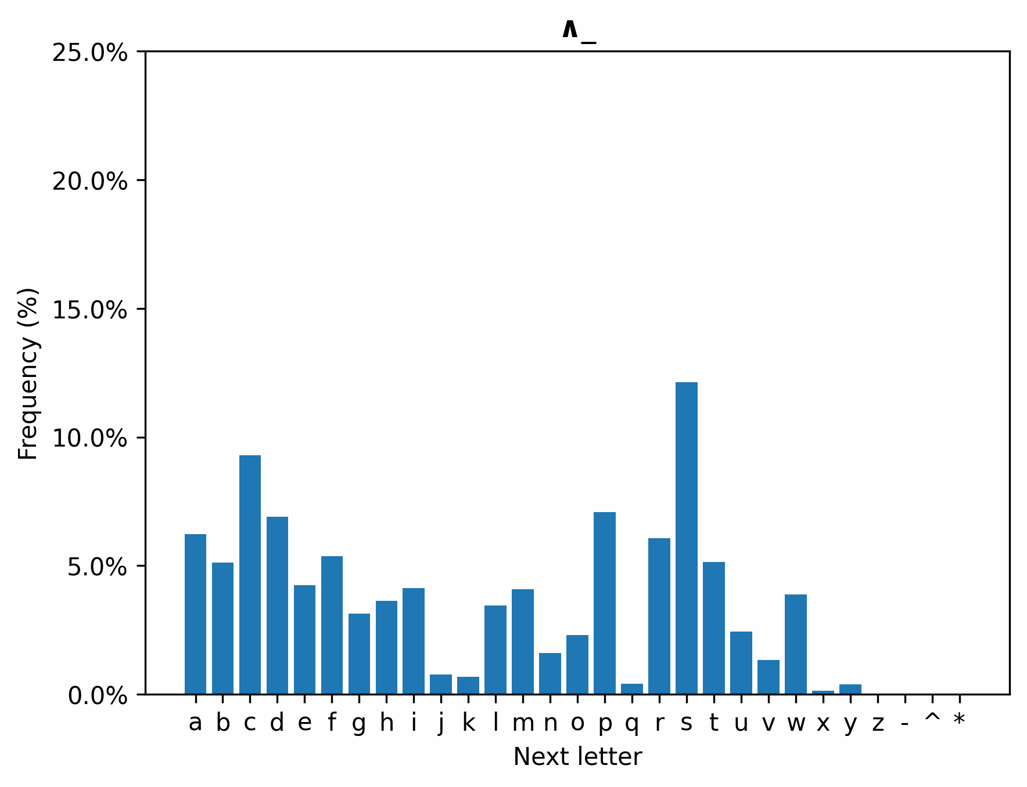
Next Letter

Slide 12
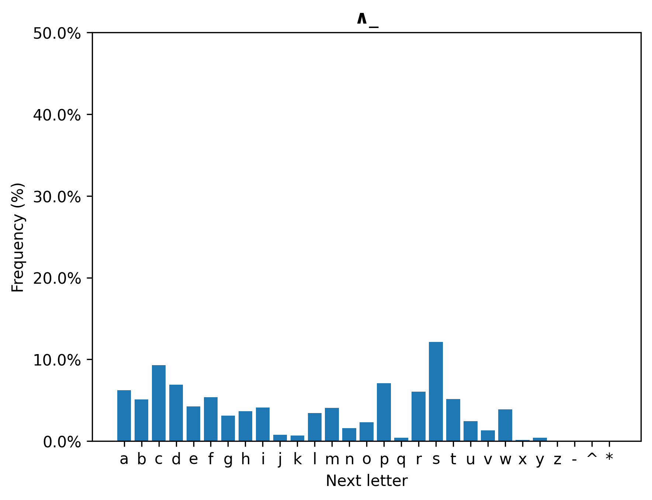
Next Letter (2)

Slide 13
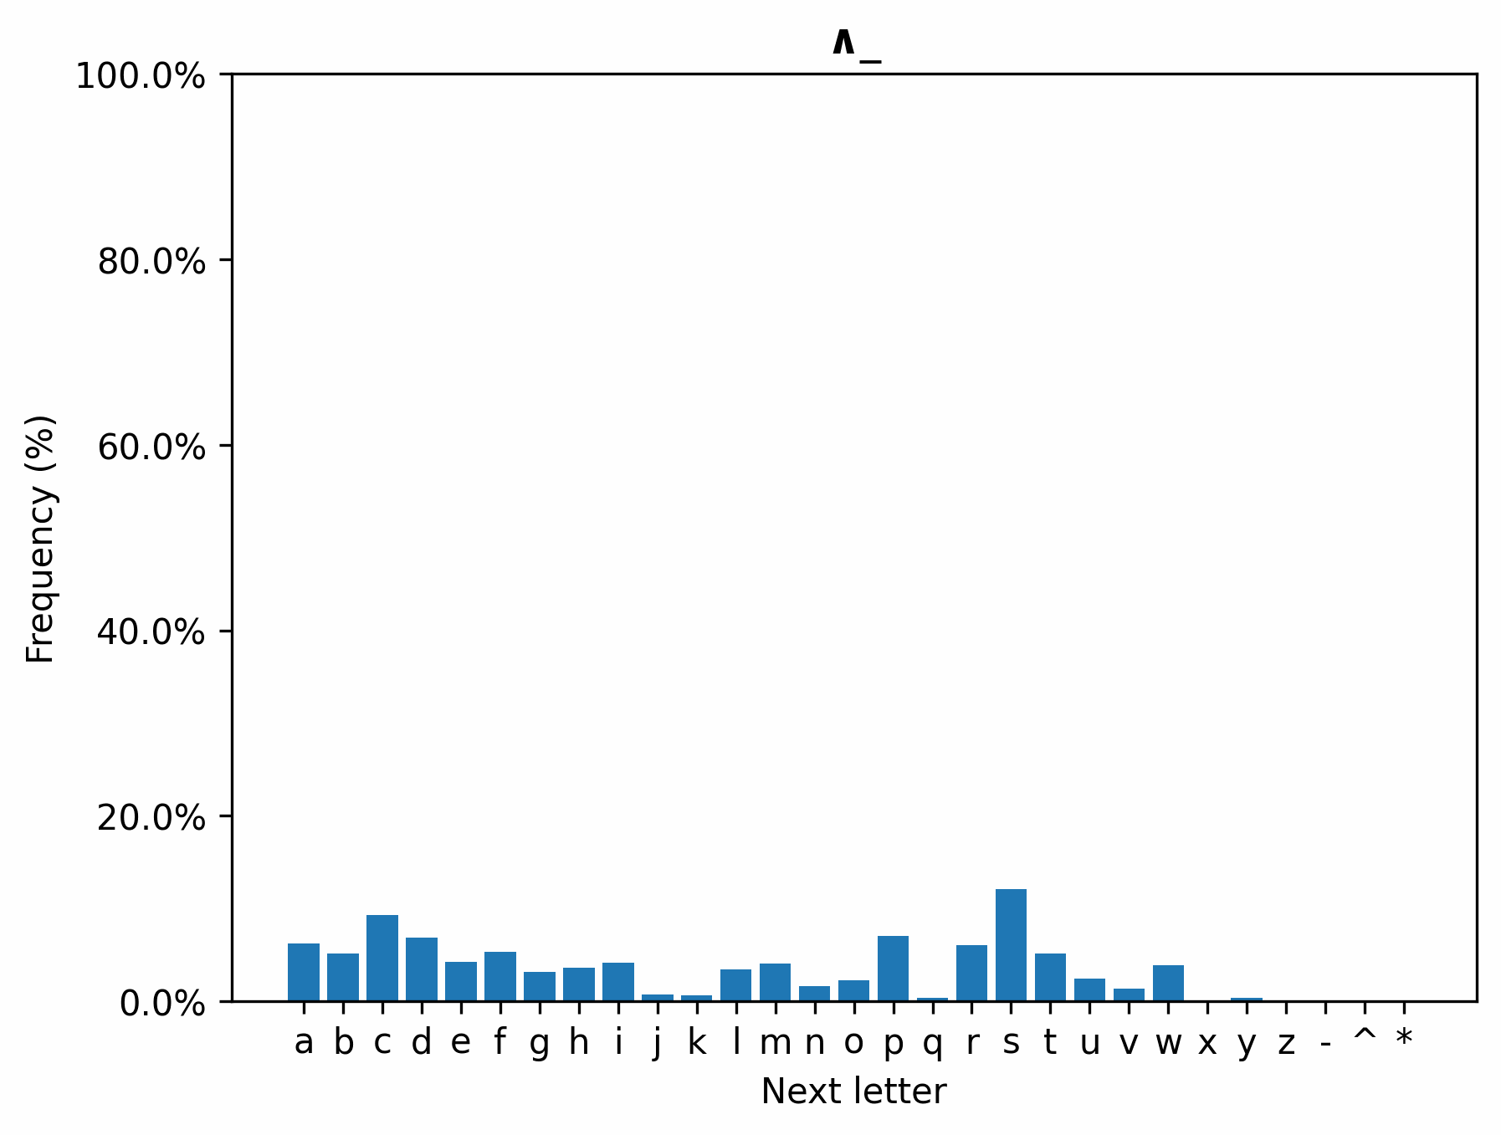
Next Letter (3)

Slide 14
Next Letter (4)

Slide 15
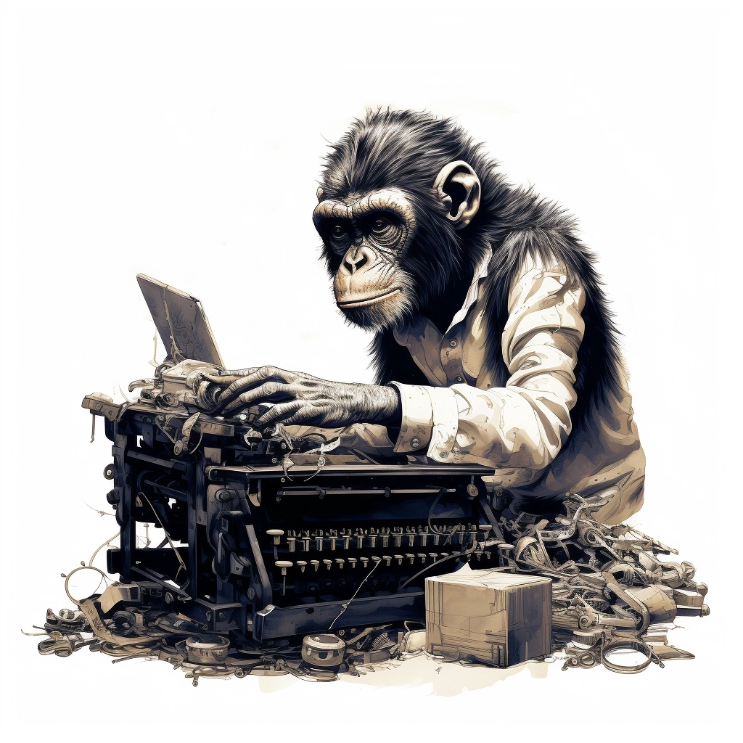
Method 3:
Dynamically weighted keyboard

Slide 16
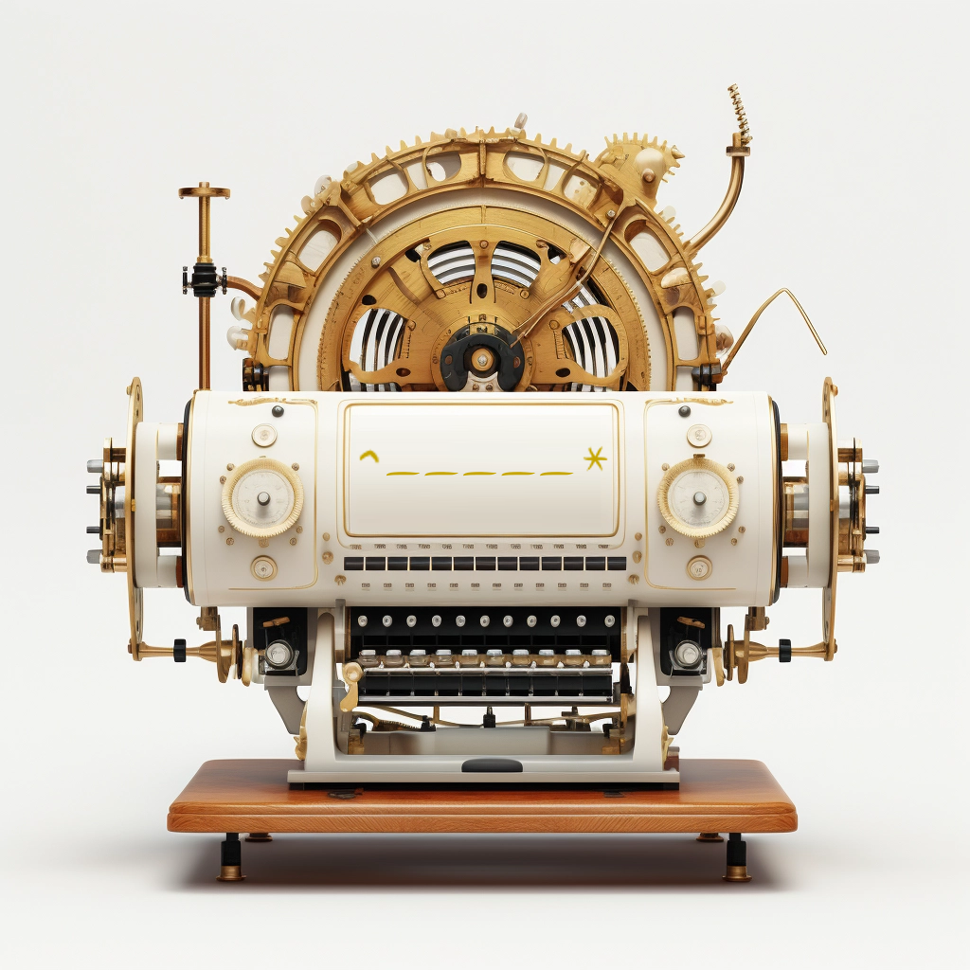
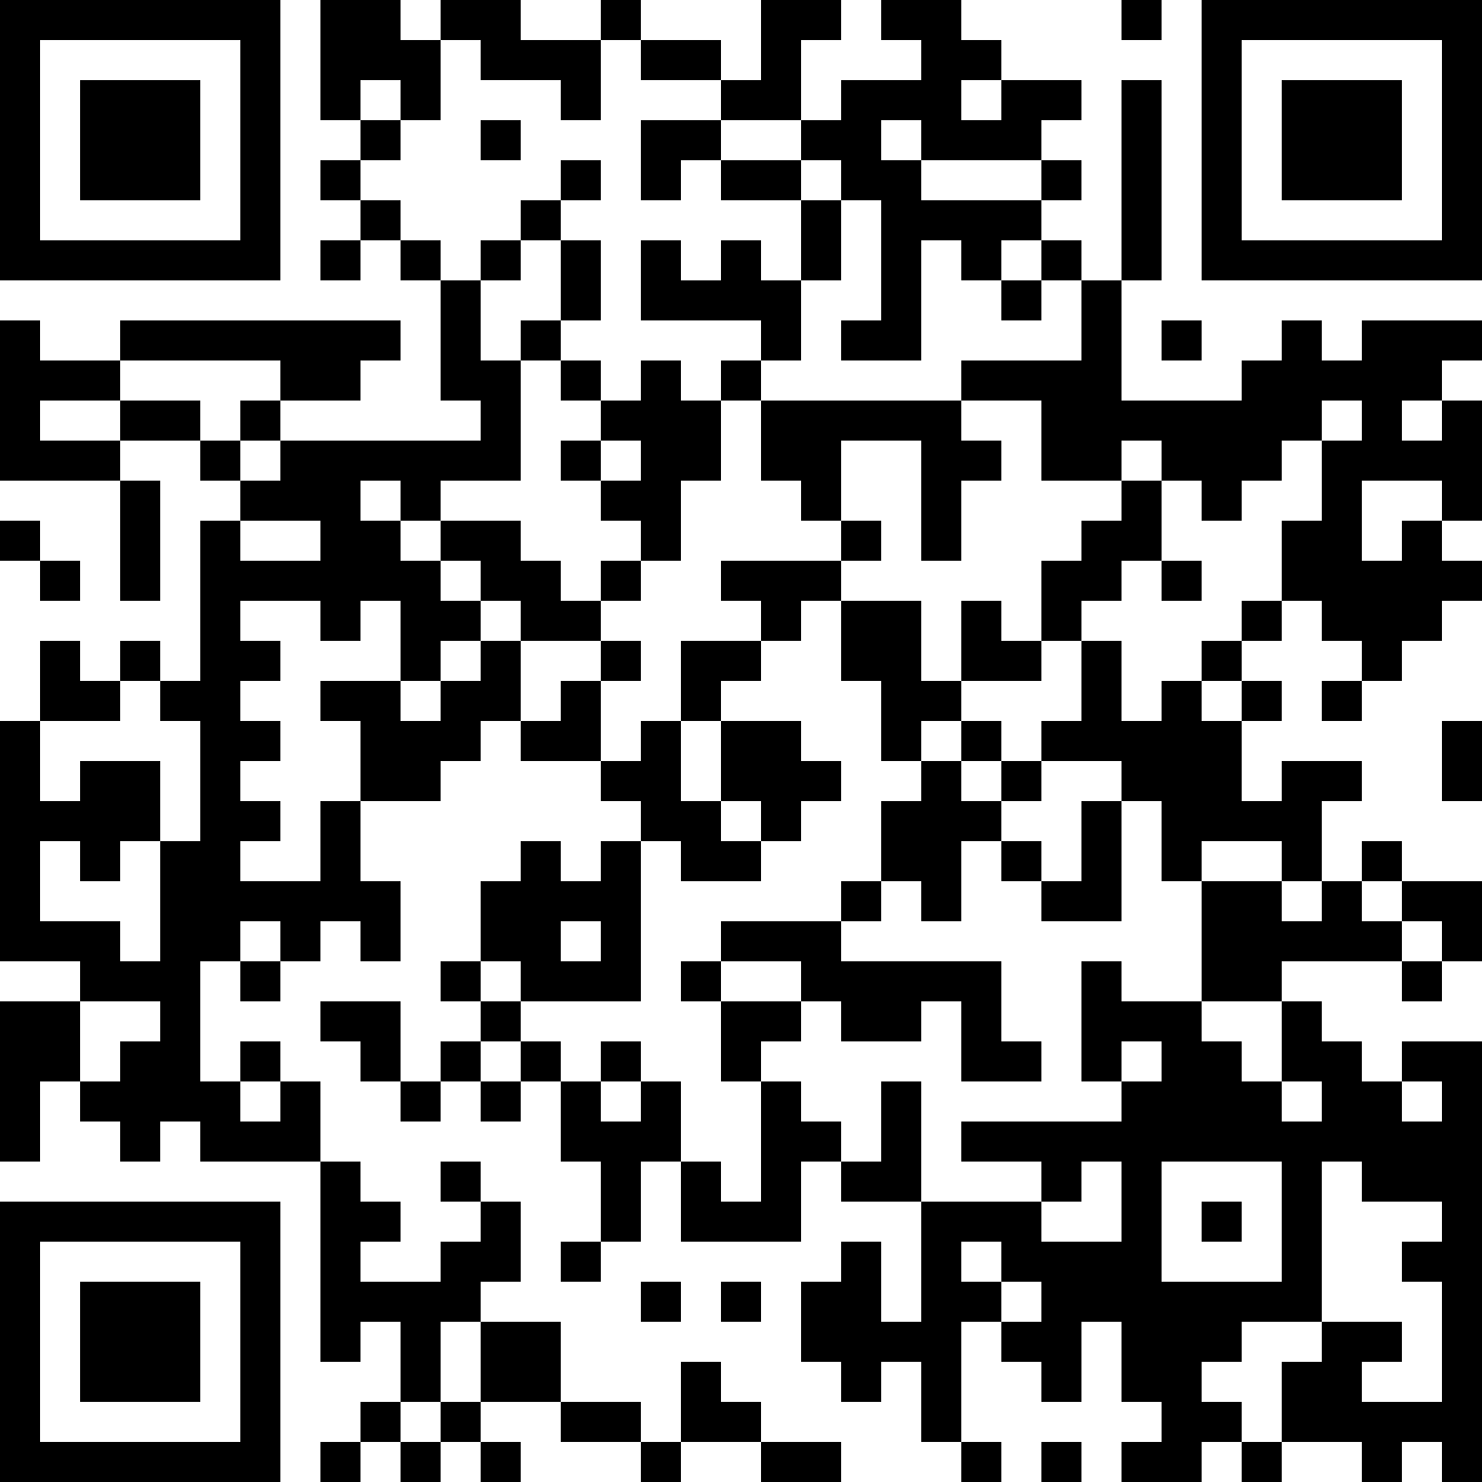
Words Generator Machine 3
https://pauldubois98.github.io/GenerativeAI/word_generator3.html

Slide 17
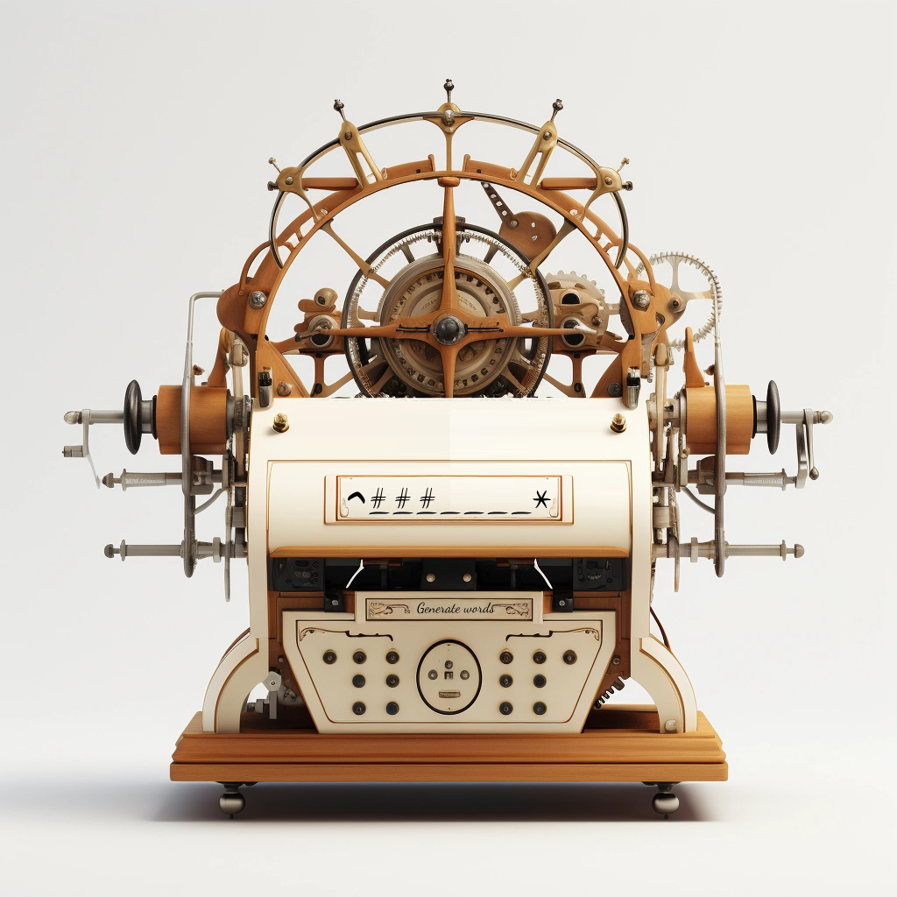
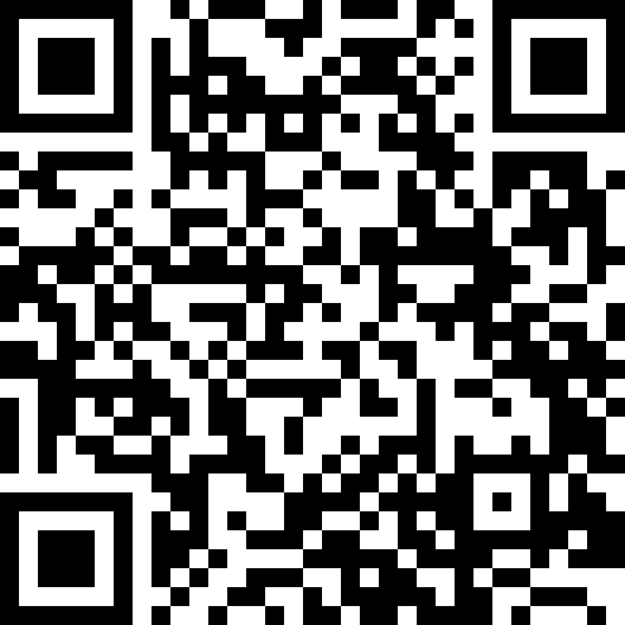
Custom Words Generator Machine 3 (bis)
https://pauldubois98.github.io/GenerativeAI/next_letters.html

Slide 18

Predict letters

Slide 19
Complete the word…
…with context
…h␣?
…e␣?
…m␣?
…a␣?
…t␣?
…i␣?
…c␣?
…s␣?
^math␣?
^mathe␣?
^mathem␣?
^mathema␣?
^mathemat␣?
^mathemati␣?
^mathematic␣?
^mathematics␣?

Slide 20
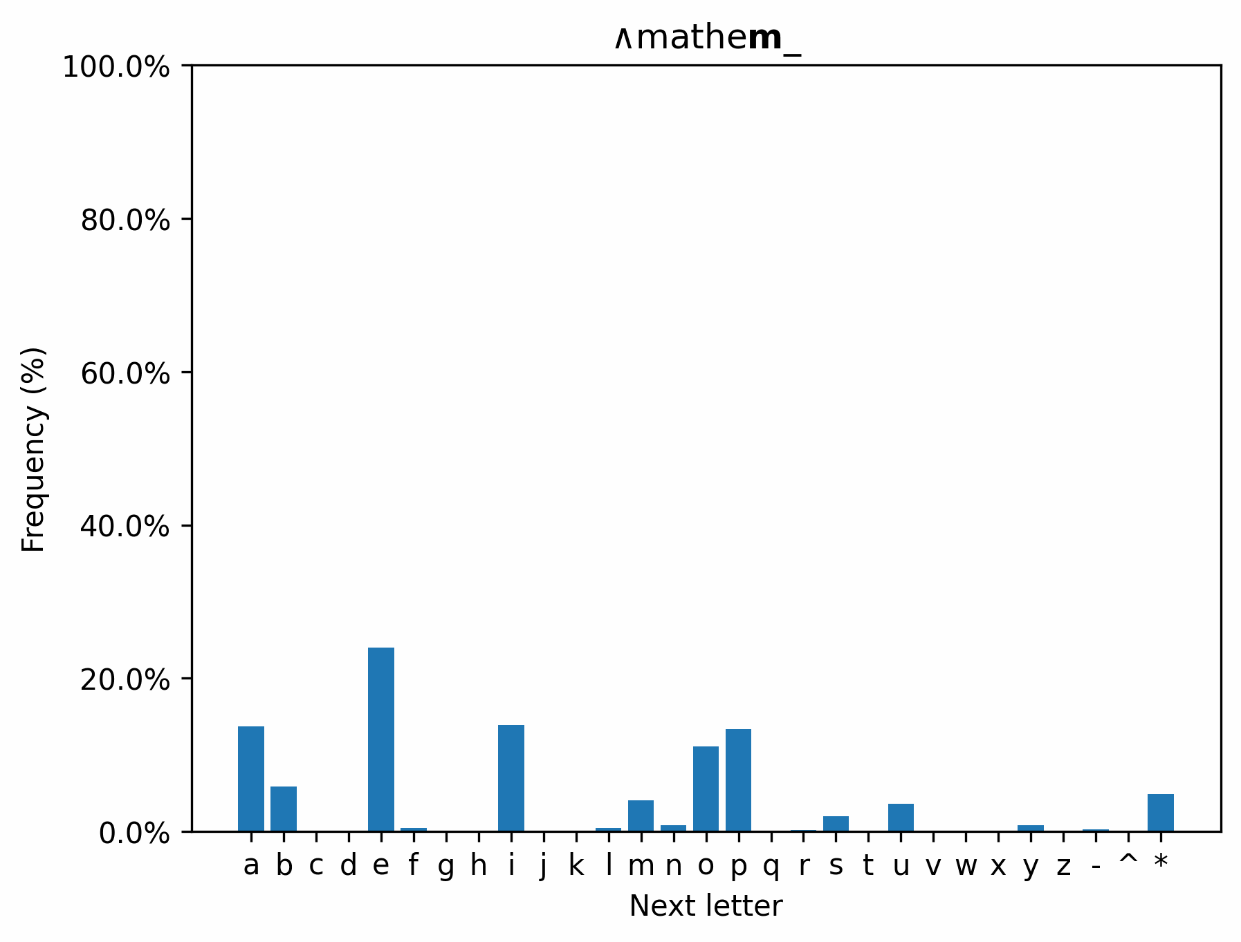
Context really helps!

Slide 21
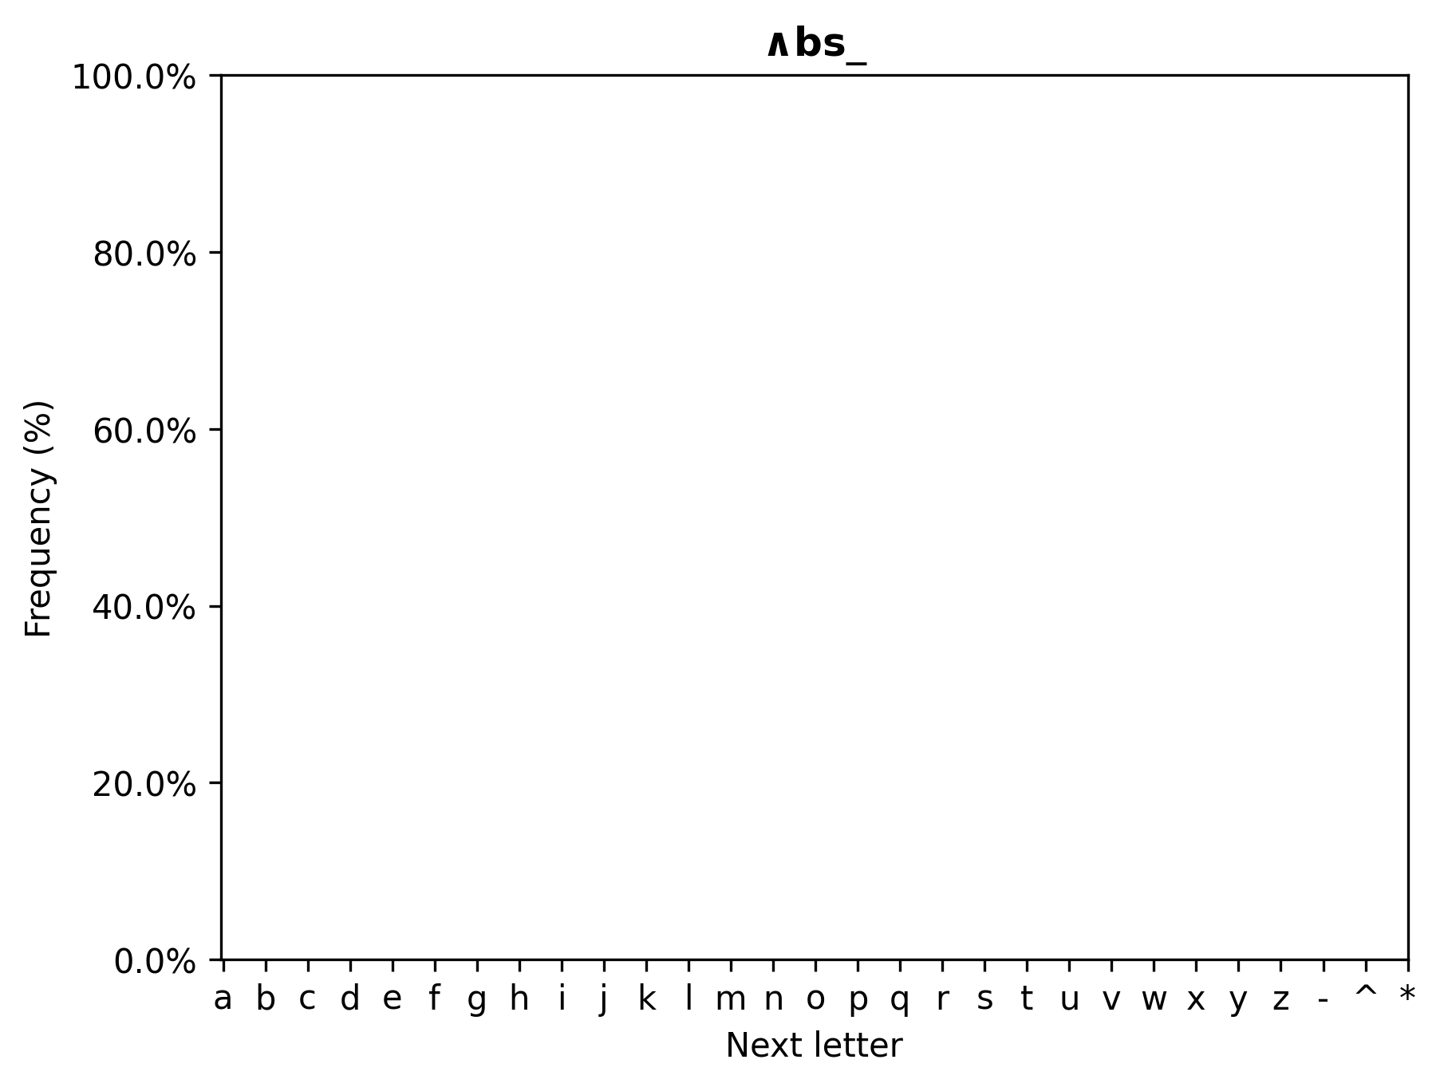
Dictionary search

Slide 22
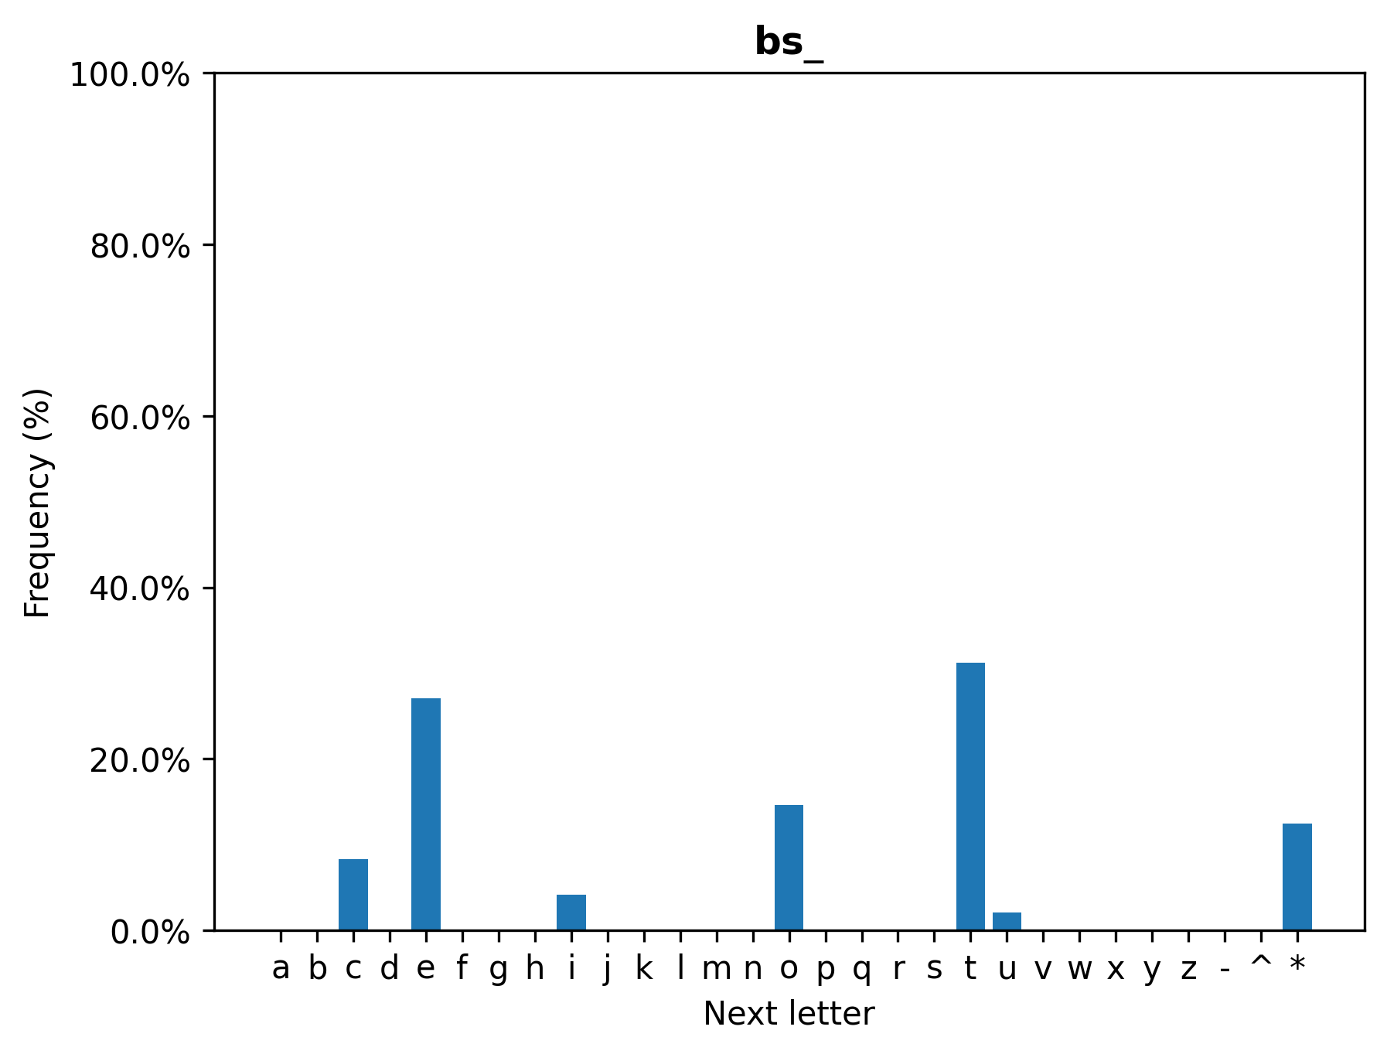
Dictionary search

Slide 23
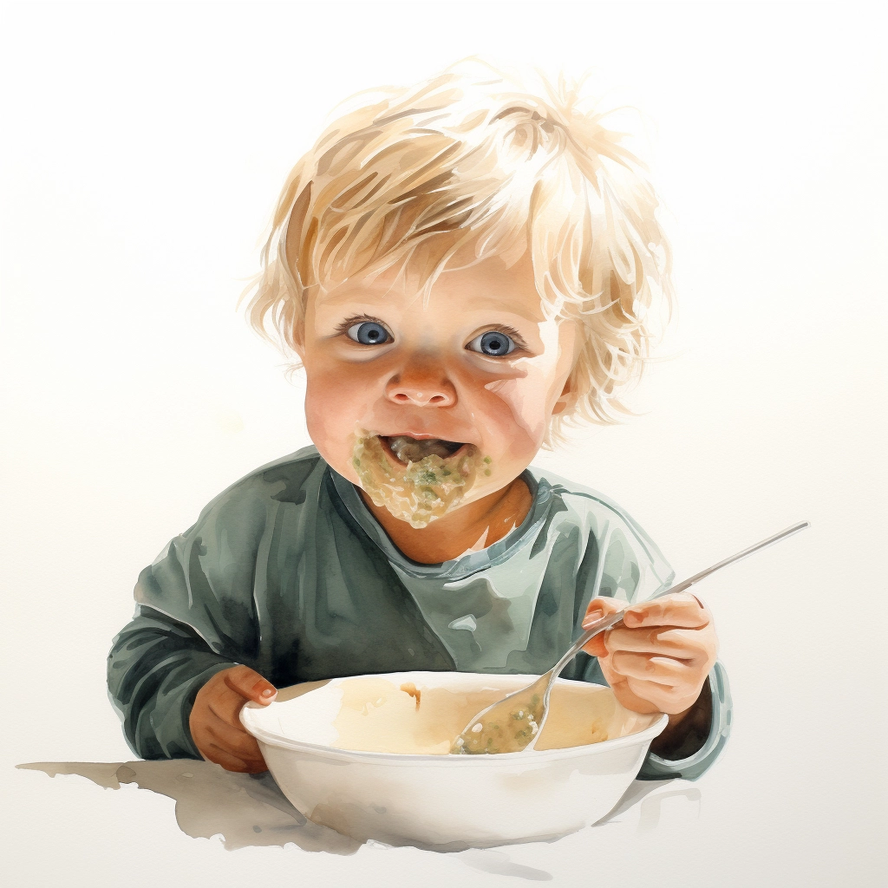
How do babies learn to eat purée?

Slide 24
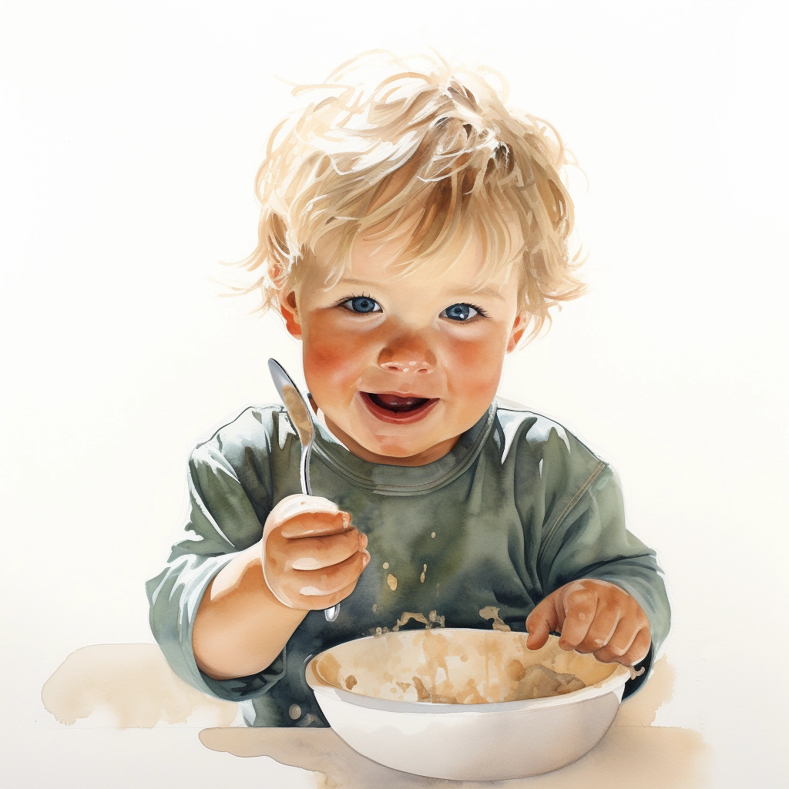
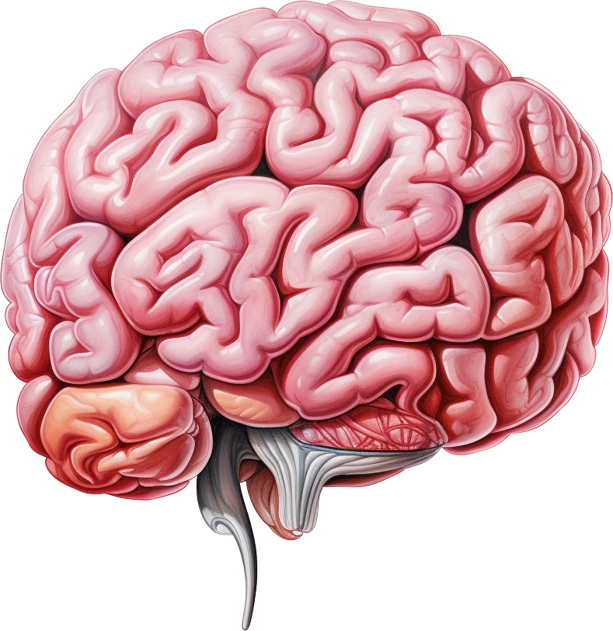

The brain

Slide 25
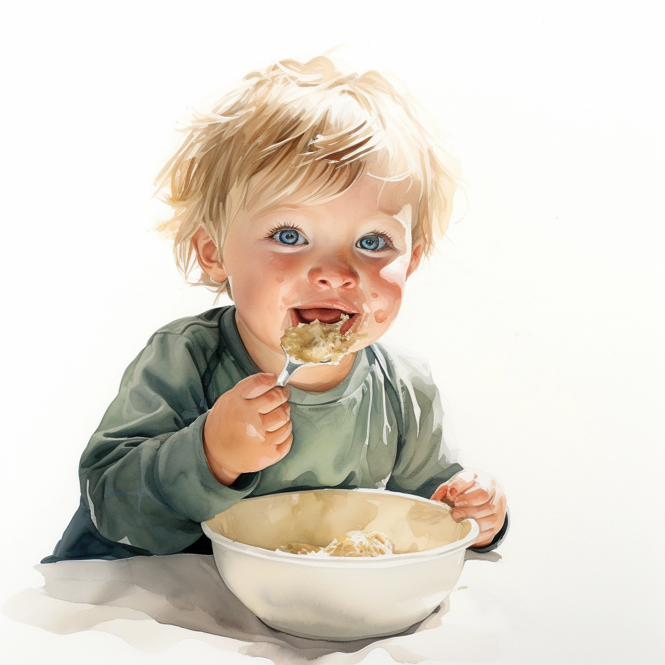
The brain

Slide 26
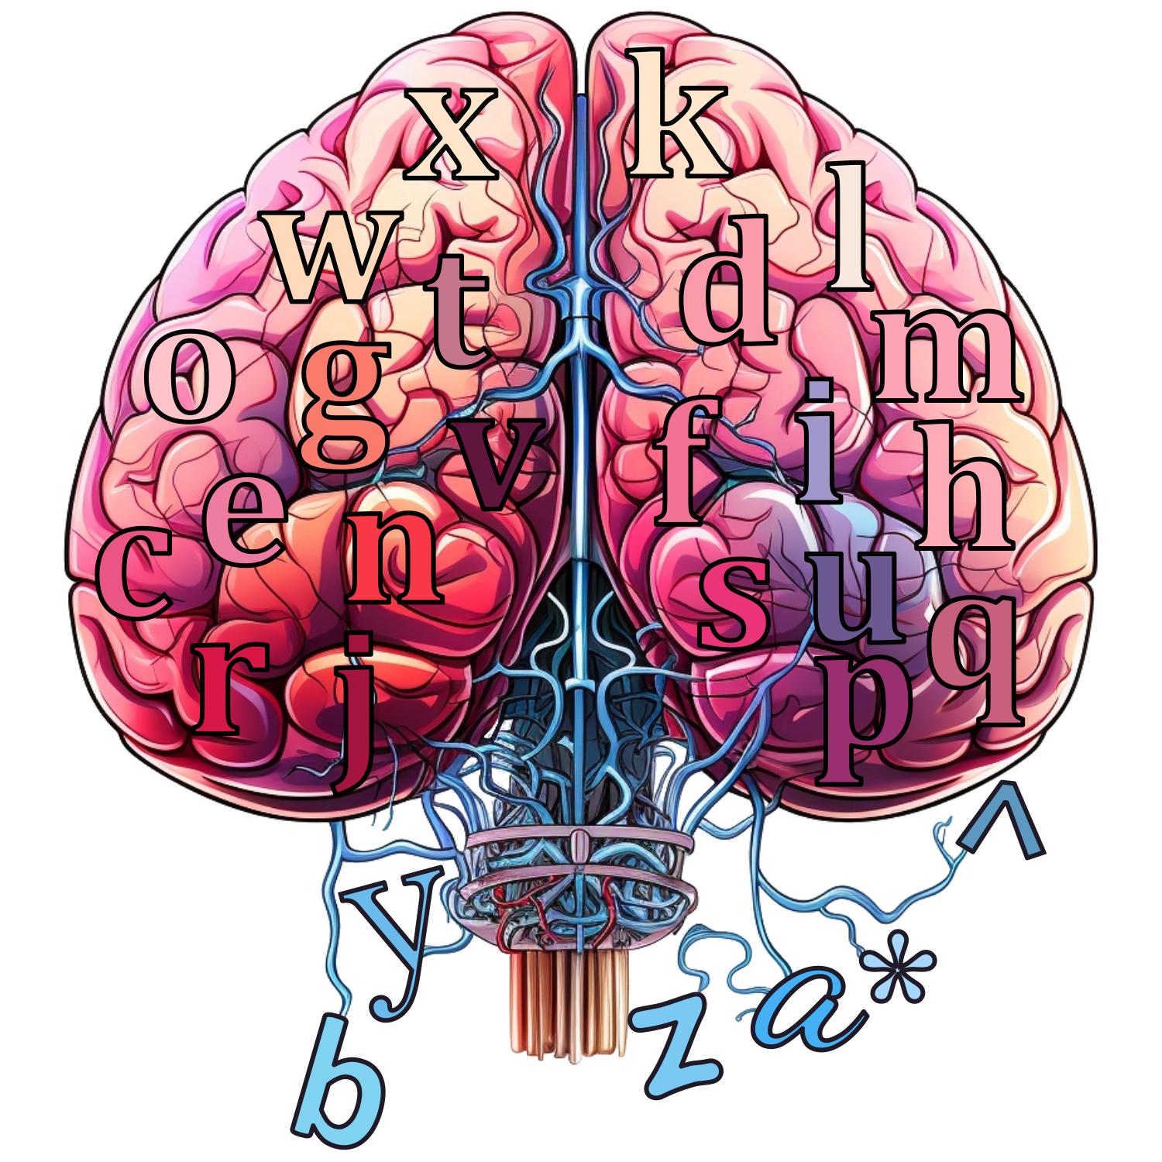
A brain to predict the next letter

Slide 27
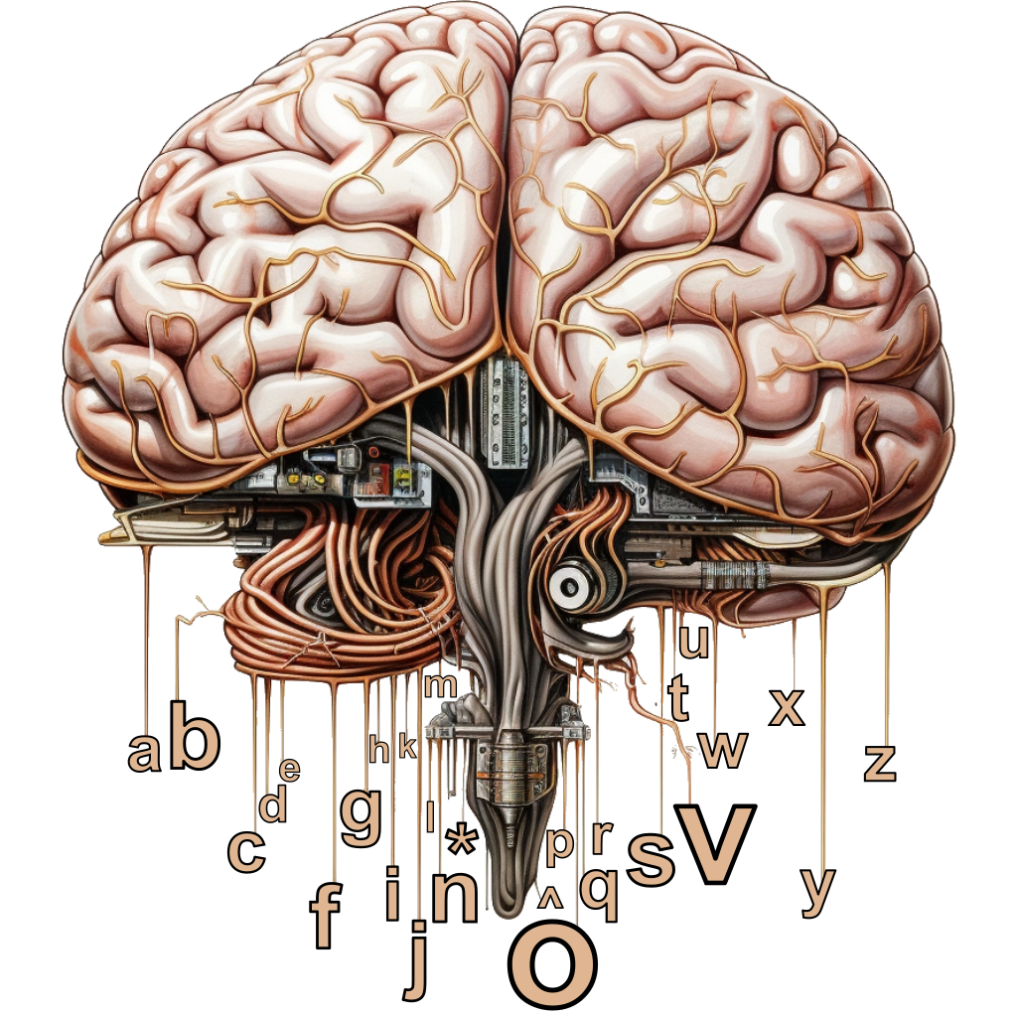
Artificial Brain
^physi_
c

Slide 28
Artificial Brain
b
a
^
*
a
a
b
b
c
c
…
…
z
z

Slide 29
Artificial Brain
^
c
a
b
*
^
^
^
^
*
a
a
a
a
a
b
b
b
b
b
c
c
c
c
c
…
…
…
…
…
z
z
z
z
z

Slide 30
Predicting the next letter of the alphabet
a → b
b → c
c → d
d → e
e → f
f → g
g → h
h → i
i → j
j → k
k → l
l → m
m → n
n → o
o → p
p → q
q → r
r → s
s → t
t → u
u → v
v → w
w → x
x → y
y → z
z → -
- → *

Slide 31
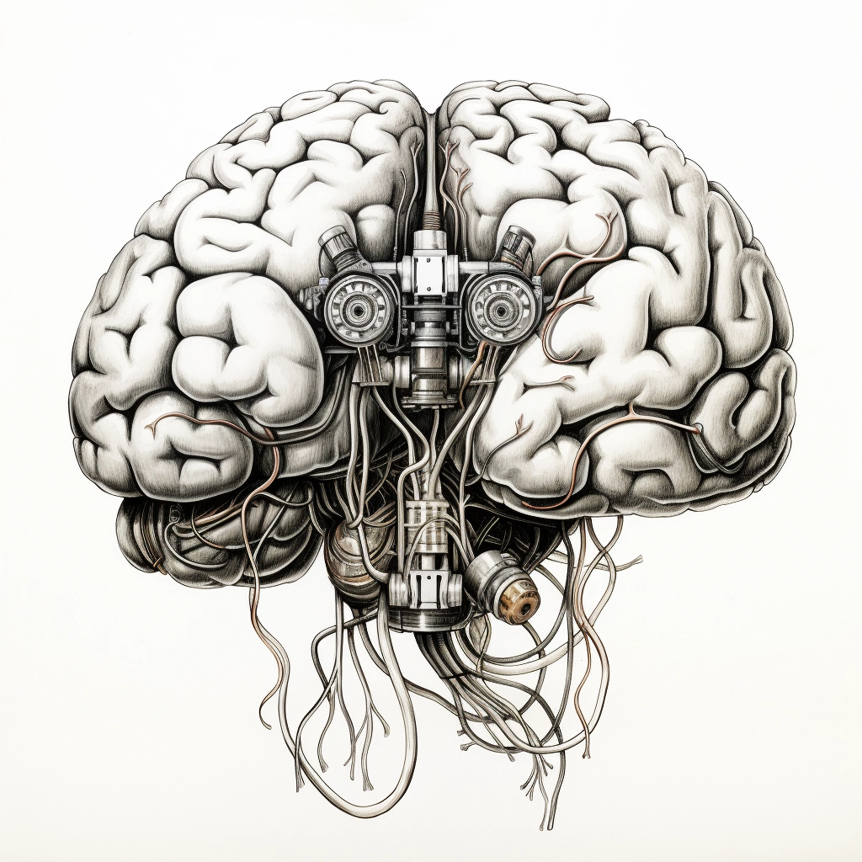
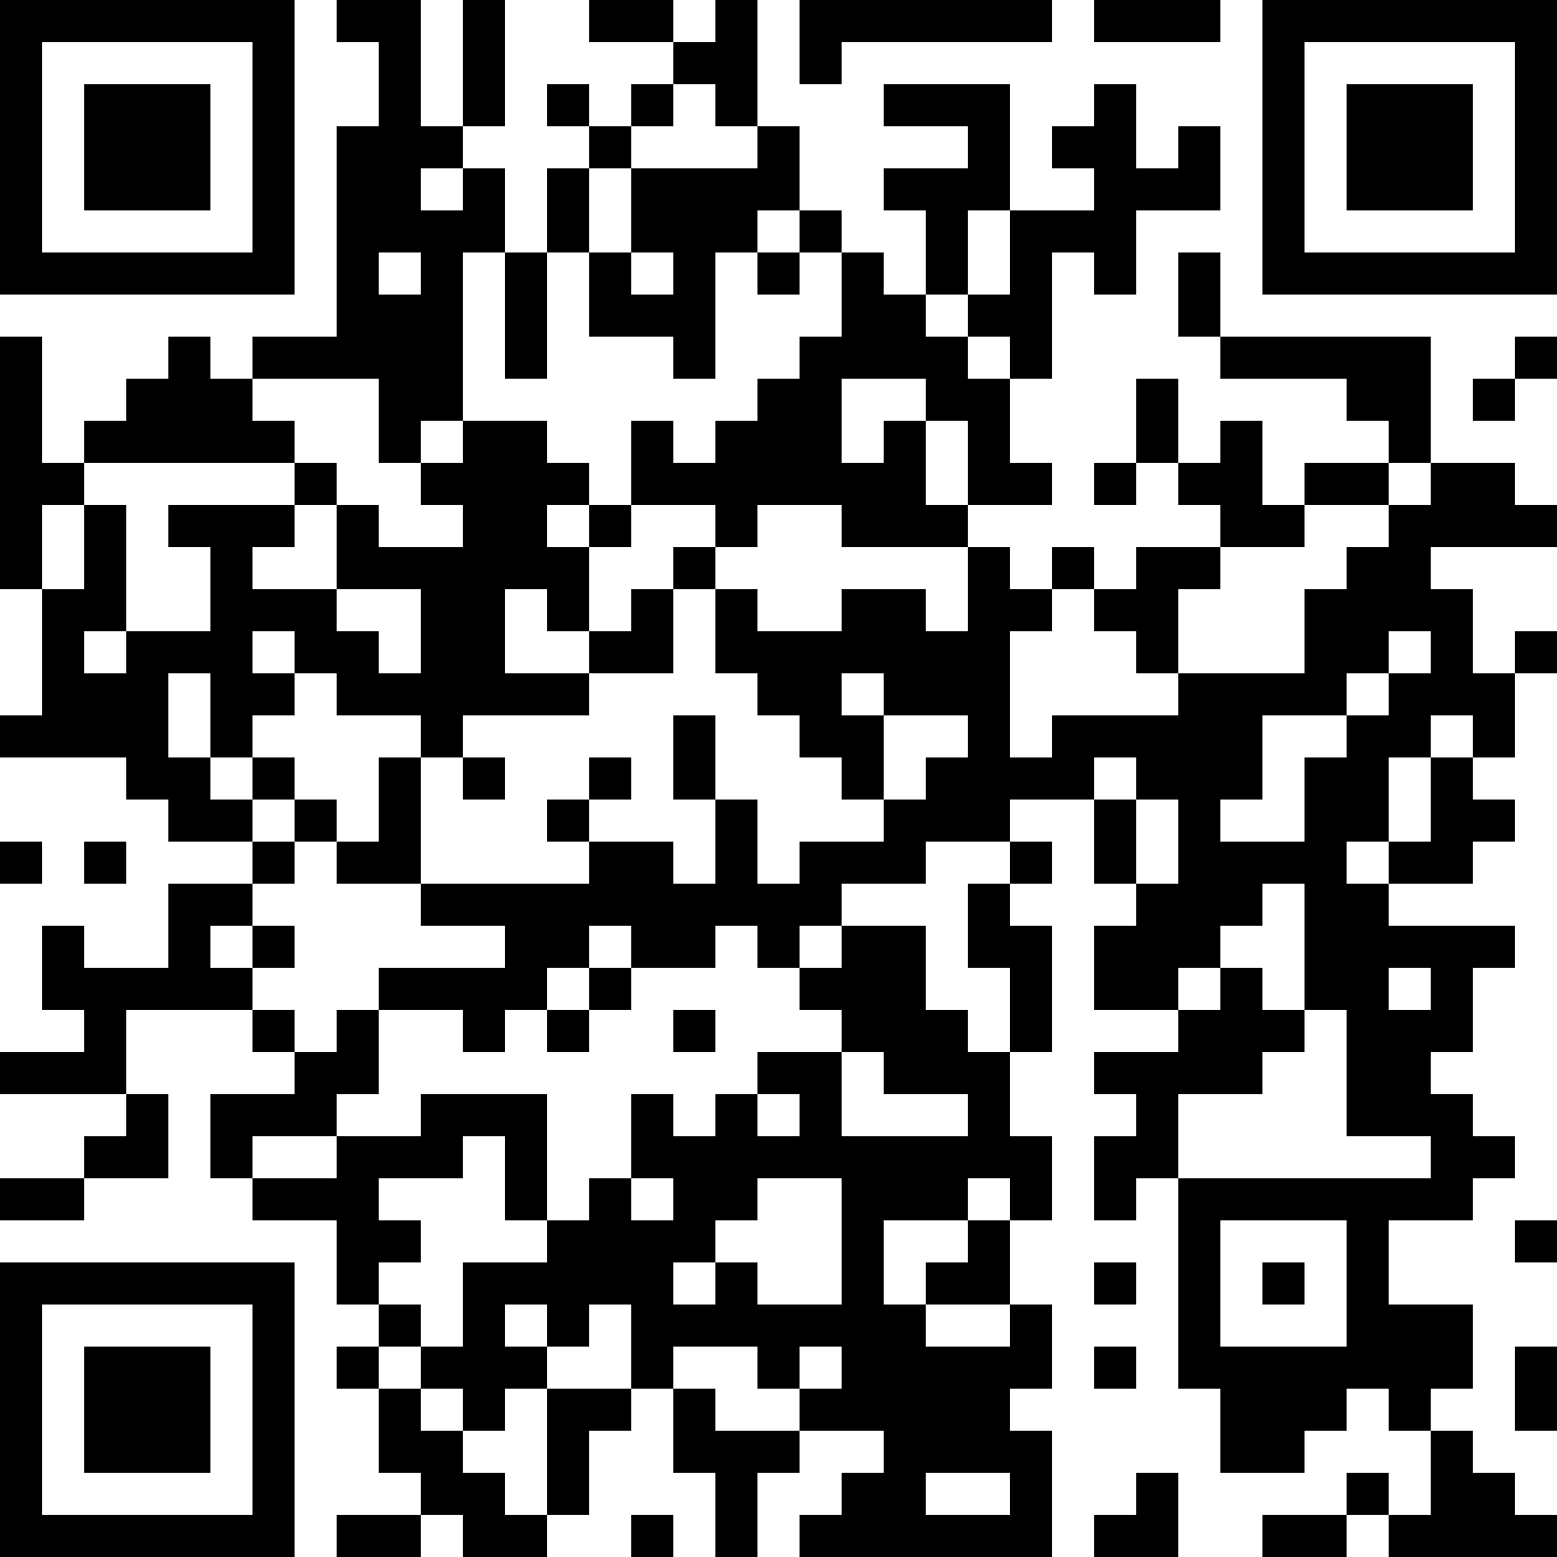
Predicting the next letter of the alphabet
https://pauldubois98.github.io/GenerativeAI/futur_letters.html?data=test

Slide 32
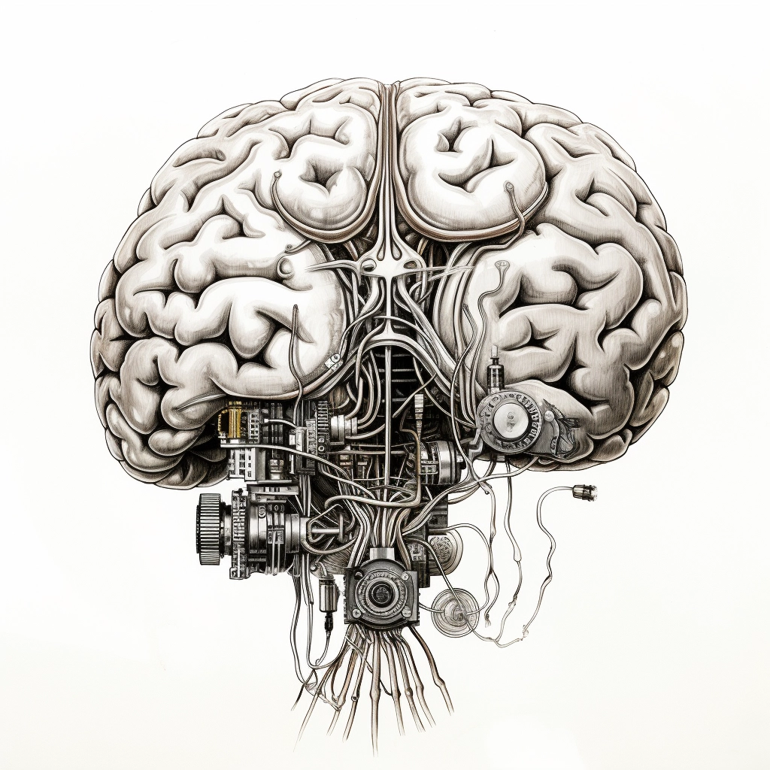
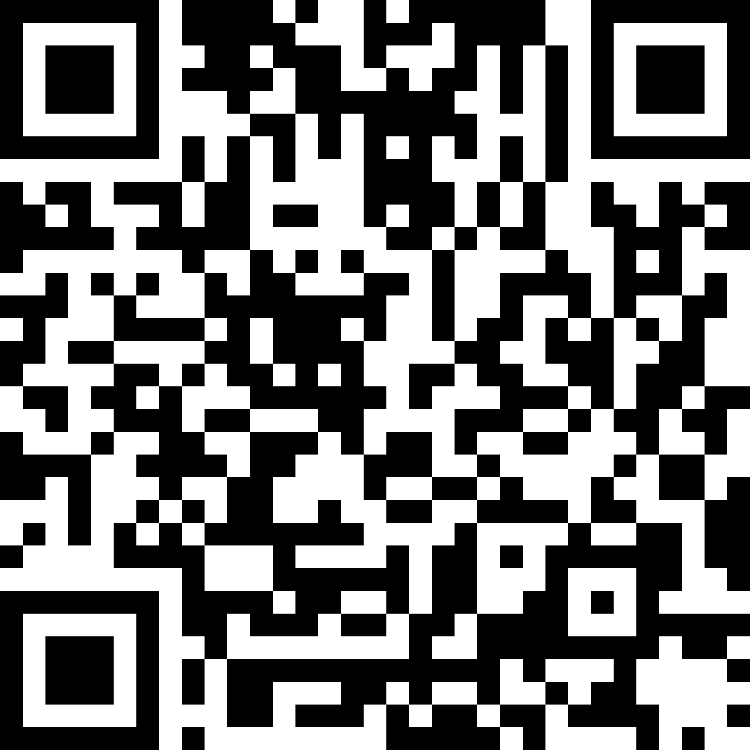
Predicting the correct next letter
https://pauldubois98.github.io/GenerativeAI/futur_letters.html

Slide 33
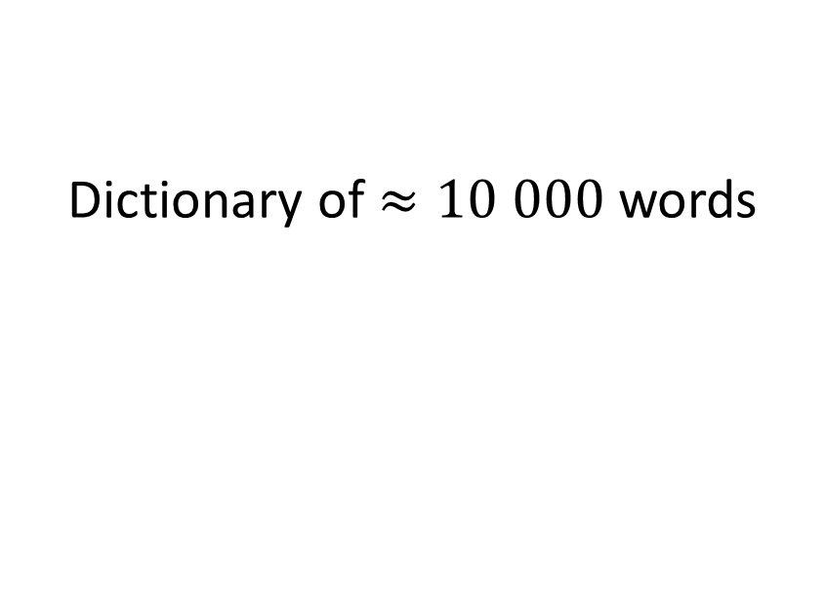
Training dataset
Ours
ChatGPT
Dictionary of $≈10 000$ words
FAQ forums
Wikipedia
Press articles
Scientific articles
School textbooks
…

Slide 34
Training resources
Ours
ChatGPT
< 10 minutes
On 1 smartphone
(or a laptop)
“34 days”
On 1023 supercomputer
(A100 GPUs)

Slide 35
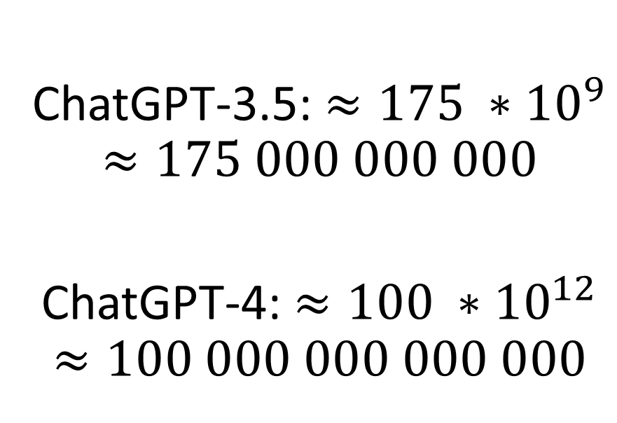
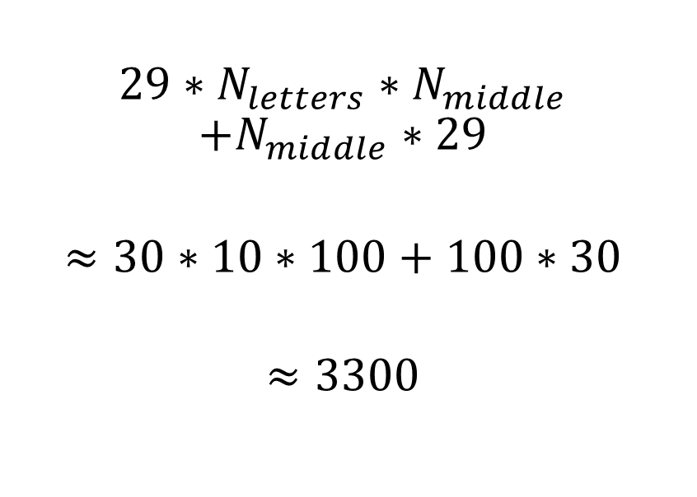
Number of parameters
Ours
ChatGPT
$$29∗N_{letters}∗N_{middle}$$
$$+N_{middle}∗29$$
$$≈30∗10∗100+100∗30$$
$$≈3300$$
ChatGPT-3.5: $≈175 ∗{10}^{9}$
$$≈175 000 000 000$$
ChatGPT-4: $≈100 ∗{10}^{12}$
$$≈100 000 000 000 000$$

Slide 36
Generator vs Discriminator

Slide 37
Denoising

